Slide 1
“Get off Mommy’s piggyback!
Share the chores!”

Slide 2
Helping at home
“Reading comprehension”
“Gender Equality”
國北教大附小 劉安湘 Anne
新生國小 李以敏 Emily
明道國小 蘇照雅 Christine
社子國小 洪雯琦 Alinda
2016. 6. 3

Slide 3
UN Women released a flagship report on the progress of the world's women:
Women around the globe do almost 2.5 times more unpaid work than men.
Pakistan women do 10 times what men do.
In Guatemala it is 5 times more.

Slide 4
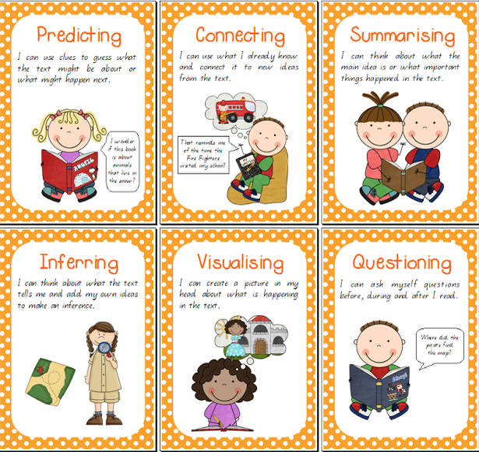
Super 6 reading strategies

Slide 5
Super 6 reading strategies
k

Slide 6
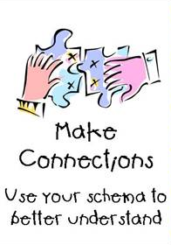
Super 6 reading strategies

Slide 7
Super 6 reading strategies

Slide 8
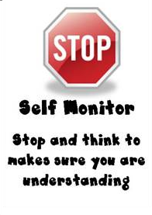
Super 6 reading strategies

Slide 9
Super 6 reading strategies

Slide 10
Super 6 reading strategies

Slide 11
6 Scaffolding Strategies to Use With Your Students --Rebecca Alber
Show and tell— (1) Fishbowl activity (2) Think aloud (3) Show students the outcome/ product before they do it

Slide 12
2. Tap into prior knowledge Ask students to share their own experiences and ideas
3. Give time to talk Students need time to process new ideas and information.
Use “think-pair-share” to structure talking time

Slide 13
4. Pre-teach vocabulary Introduce the words in photos and in context to things students know and are interested in. Use the dictionary whenever possible.

Slide 14
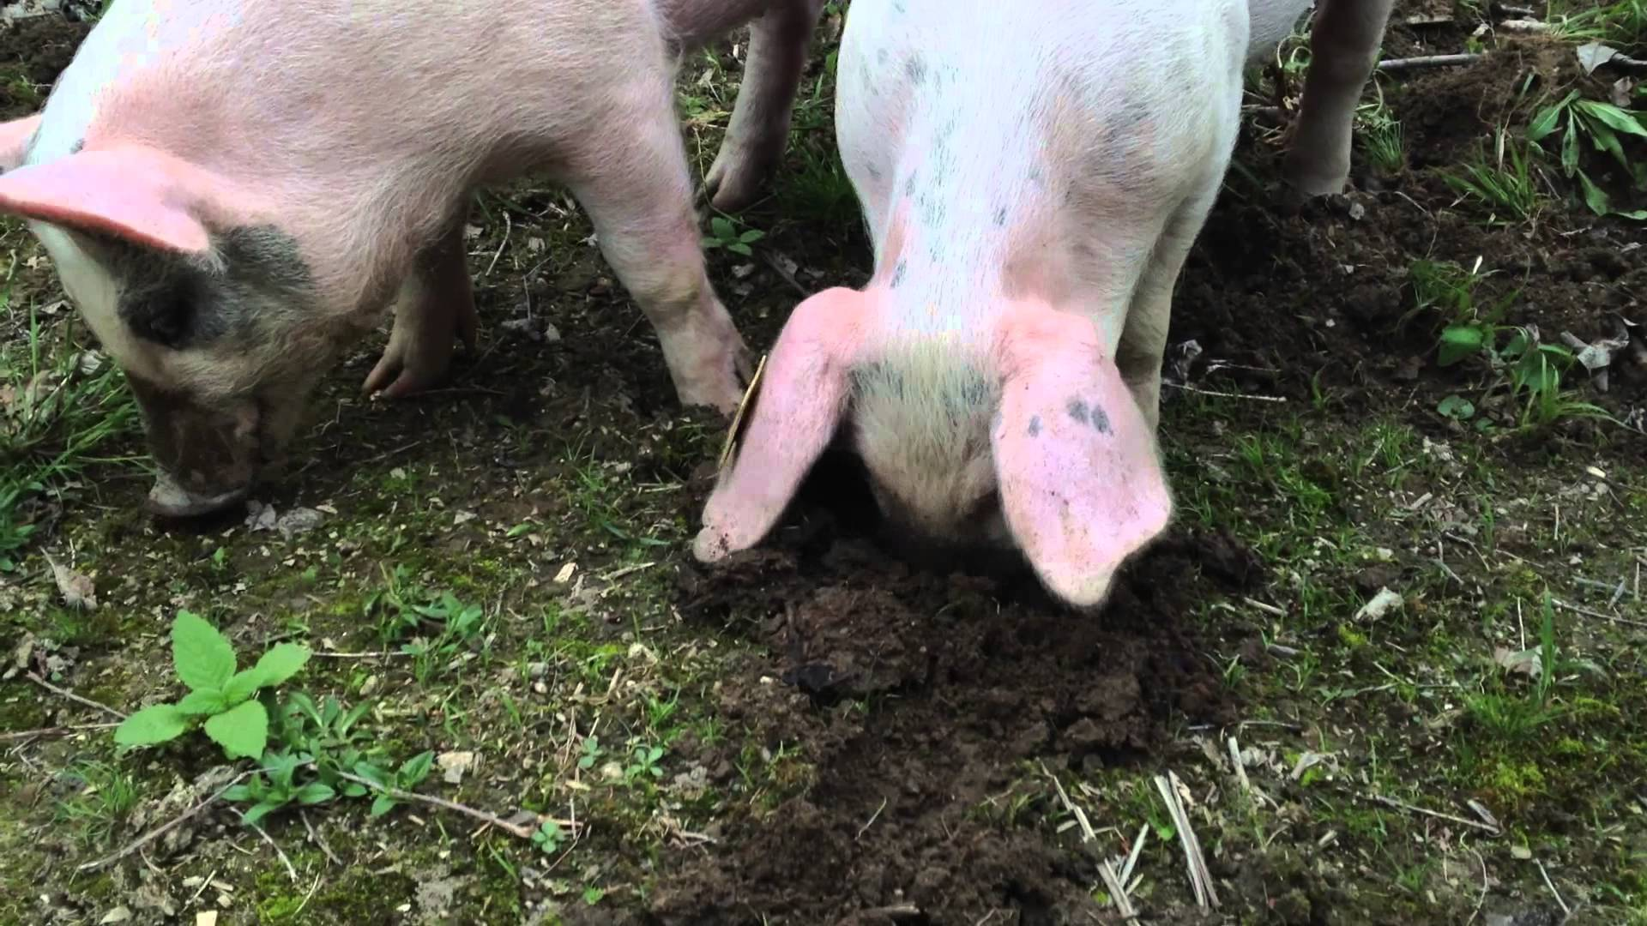
root around

Slide 15
5. Use visual aids Graphic organizer (eg. Mind map), pictures, and charts help students visually represent their ideas, organize information, and grasp concepts such as sequencing and cause and effect.

Slide 16
6. Pause, ask questions,
Pause, review This is a wonderful way to check for understanding while students read a chunk of difficult text or learn a new concept or content.

Slide 17
Pre-reading lesson

Slide 18
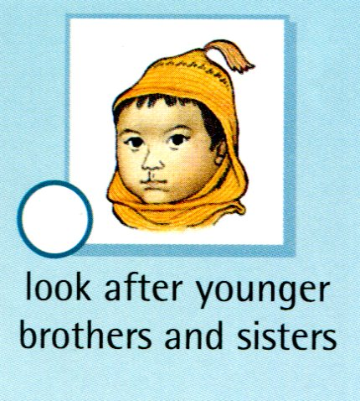
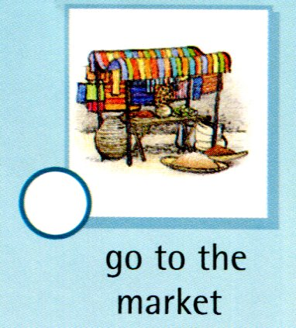
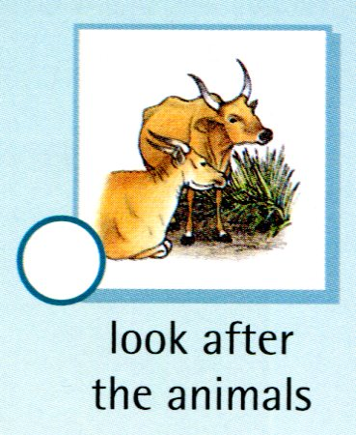
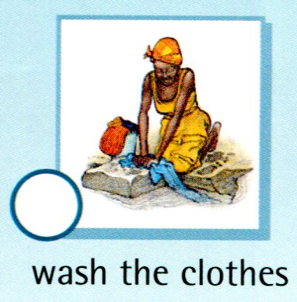
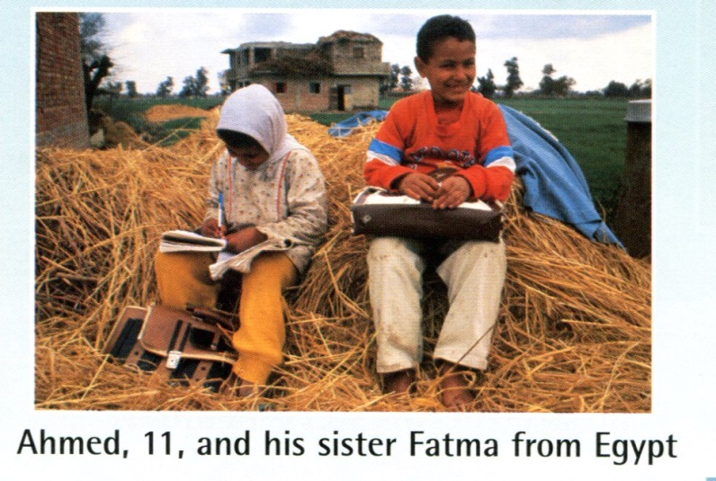
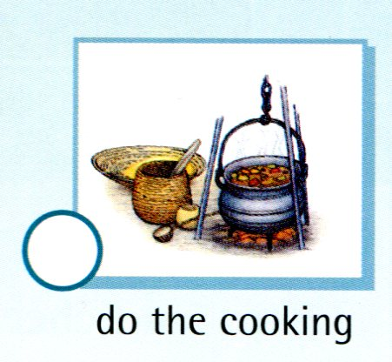
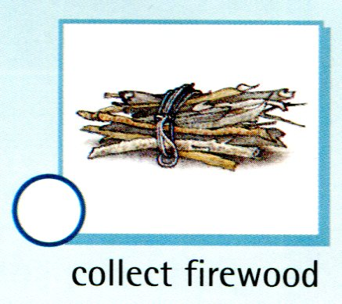
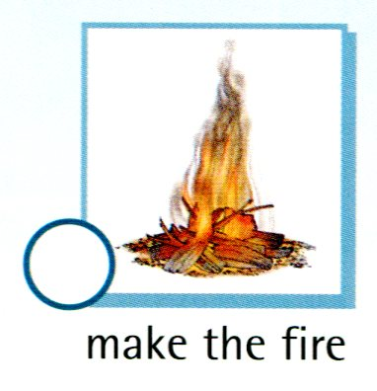
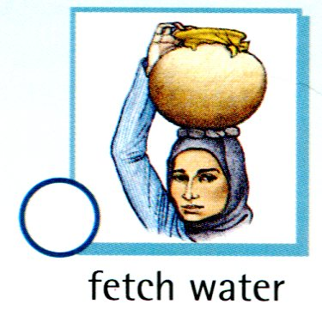
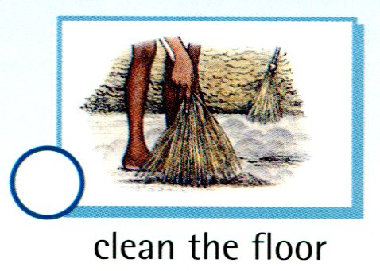
L
A
J
L
L
J
A
A
A

Slide 19
Reading lesson

Slide 20
Gender
Equality
Text
Helping at Home
Different Countries
Reader
Piggybook
Video
Before
After
Discussion
Graphic
Nepal
Kenya
Egypt
https://www.youtube.com/watch?v=XlcaDhRu1AQ
Lesson Structure

Slide 21
Piggybook Lesson Plan
Teaching Procedure | strategies
Warm-up: Talk about house chores with Ss. Who does what chores at home? | Making Connections

Slide 22
Pre-Reading… Present book cover What do you see on the cover? Does everyone look happy? What can you tell from the title? What do you think this story is about? Show picture of the first opening and ask questions. What do you see in the picture? What’s missing in this picture? What do you think mom is doing? | Questioning Predicting Predicting (words/ phrases)

Slide 23
During Reading… Have Ss look at the pictures and describe what’s happening. What are they shouting? What is Mrs. Piggot doing? You can’t see Mr. Piggot’s face(it’s covered by the newspaper), but can you imagine his expressions? The class read the story. Pause to ask questions or have Ss retell the story to check comprehension, e.g. “What happened?” | Visualizing (sketch to stretch) Monitoring (read, cover, remember, retell)

Slide 24
Post-Reading… Have students discuss and complete worksheet. Have students discuss and write down the key sentences when they share the chores at home. As a group, read the key sentences out loud. | Summarizing (Key Word Strategy/ Team Retelling)

Slide 25
Review “Chores”—(1)connect children’s personal experience (2) compare with children around the world (Aren’t we lucky?)

Slide 26
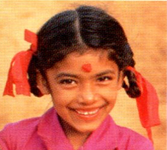
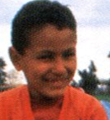
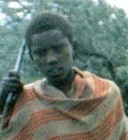
Lalkali
Nepal
Egypt
Ahmed
Kenya
Jomo

Slide 27
He has to look after the animals and collect firewood.

Slide 28
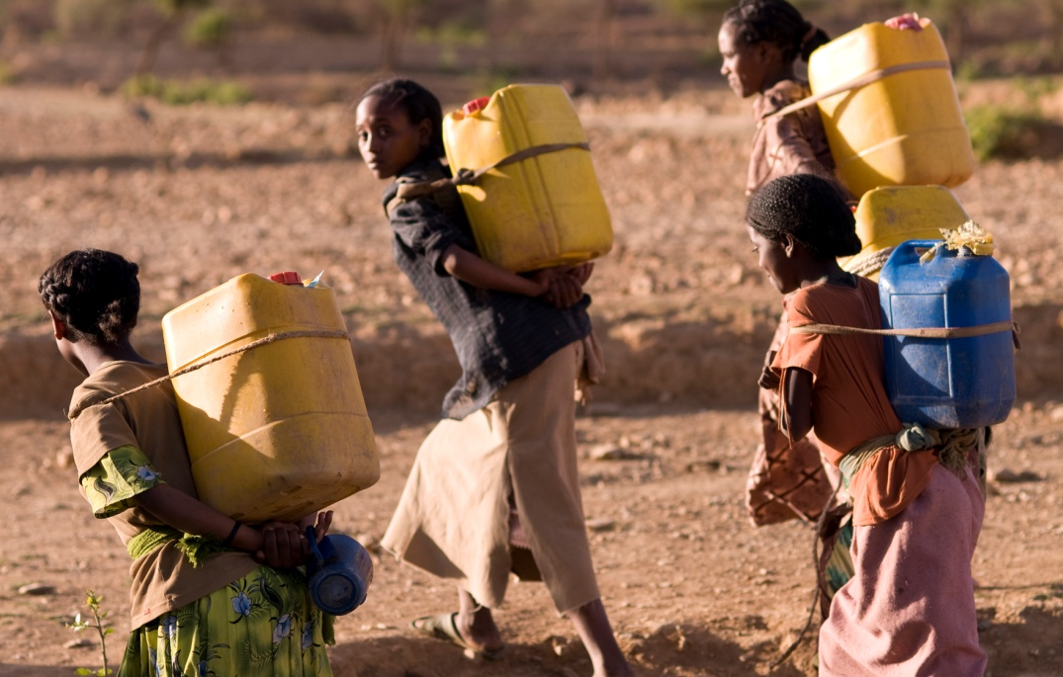
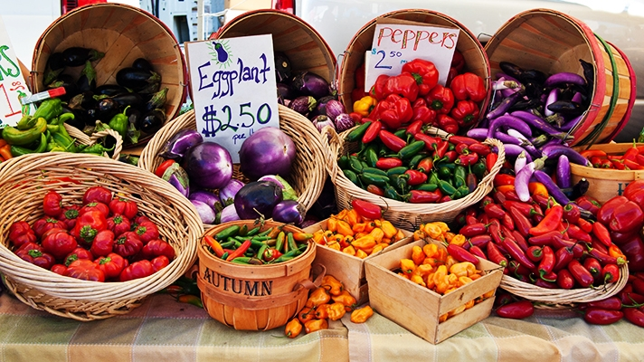
He has to make the fire, clean the floor, fetch water, and go to the market.
go to the market
Ahmed
fetch water

Slide 29
She has to look after her younger brothers and sisters, do the cooking, and wash the clothes.

Slide 30
Do you like their chores?

Slide 31
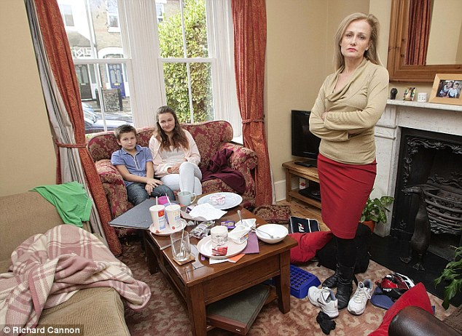
2. Reflection— Who should do the chores?

Slide 32
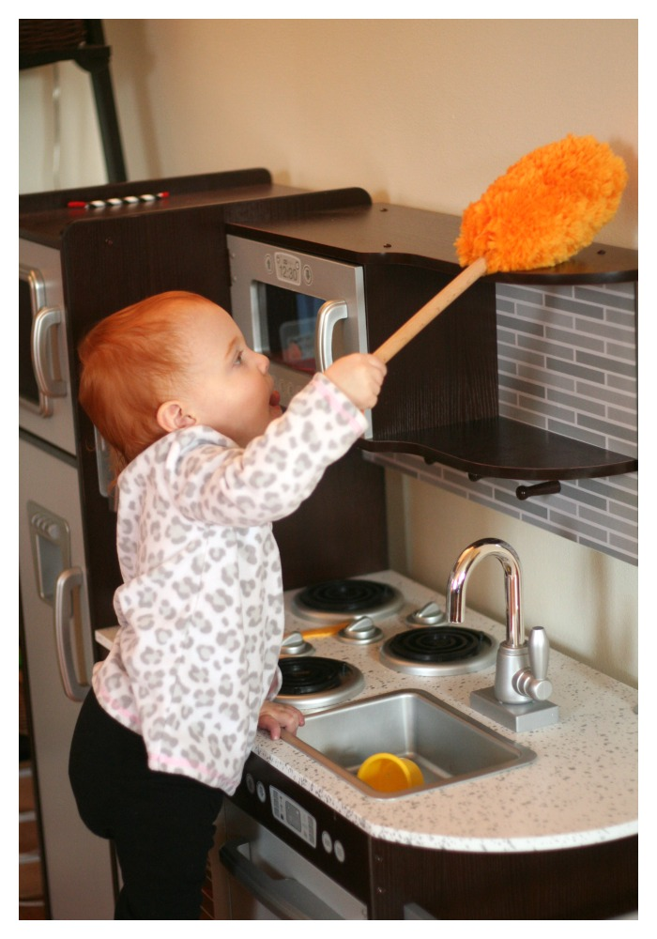
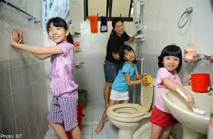
Why do we have to do chores?

Slide 33
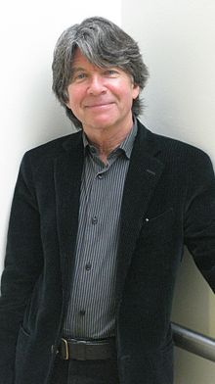
3. Piggybook— Colors (What do you see?) Sounds(What do you hear?) Actions (From humans to pigs and back)

Slide 34
Piggyback
Anthony Browne

Slide 35
Piggybook
Color is one of the most emotionally evocative of artistic elements.
Dr. Chi-Fen Emily Chen
National Kaohsiung First University of Science & Technology, Taiwan

Slide 36
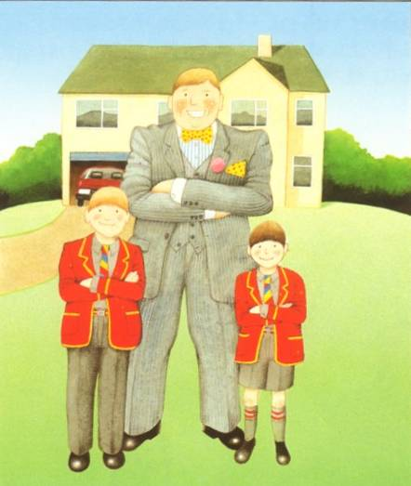
Red and yellow (warm or hot colors): suggesting excitement, warmth, happiness.
Dr. Chi-Fen Emily Chen
National Kaohsiung First University of Science & Technology, Taiwan

Slide 37
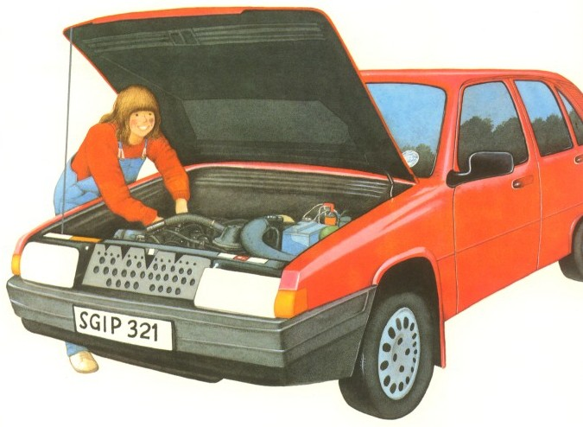
However, red can also signify danger or boldness, and
yellow cowardice or cheerfulness.
Dr. Chi-Fen Emily Chen
National Kaohsiung First University of Science & Technology, Taiwan

Slide 38
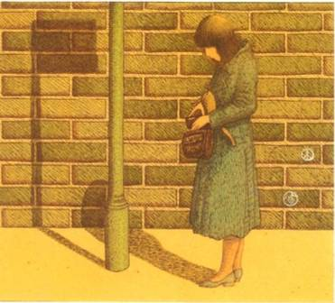
Value describes the overall intensity or strength of the light.
Dr. Chi-Fen Emily Chen
National Kaohsiung First University of Science & Technology, Taiwan

Slide 39
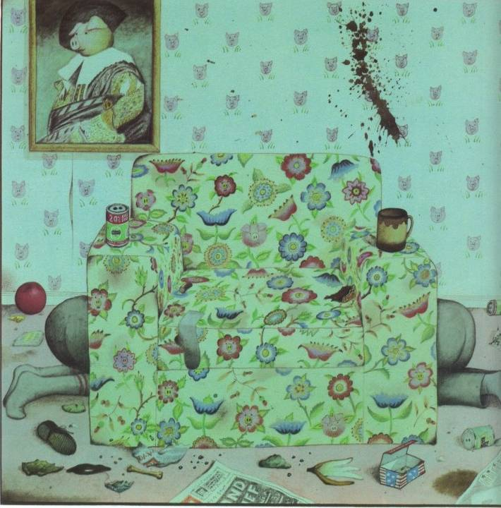
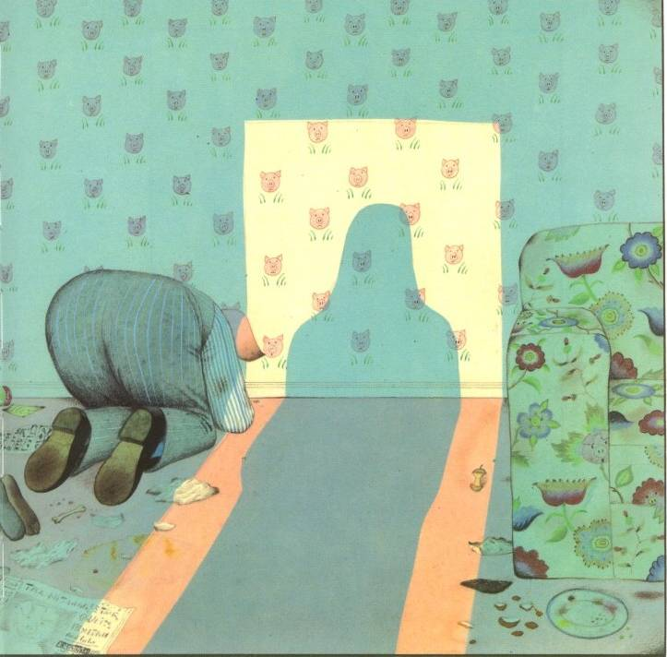
Darker values are usually associated with gloomier subjects, while lighter ones with happier subjects.
Dr. Chi-Fen Emily Chen
National Kaohsiung First University of Science & Technology, Taiwan

Slide 40
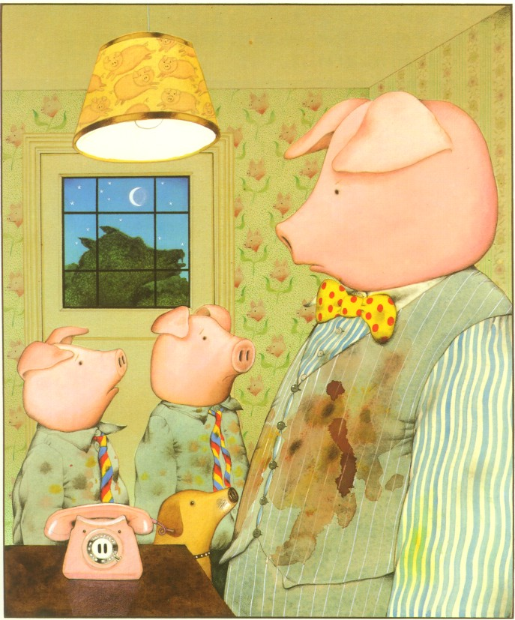
“When is Mom coming home?” the boys squealed after another horrible meal.
“How should I know?”
Notes:
“When is Mom coming home?” the boys squealed after another horrible meal.
“How should I know?” Mr. Piggott grunted. They all become more and more grumpy.

Slide 41
4. Critical thinking— Think about our roles in a family. (Gender Equality)

Slide 42
Why did Mrs. Piggott have to leave?

Slide 43
Chores | Mother | Father | Sons
washed the dishes
made the beds
vacuumed the carpets
washed the clothes
ironed the clothes
cooked the meals
✔
Before
✔
✔
✔
✔
✔

Slide 44
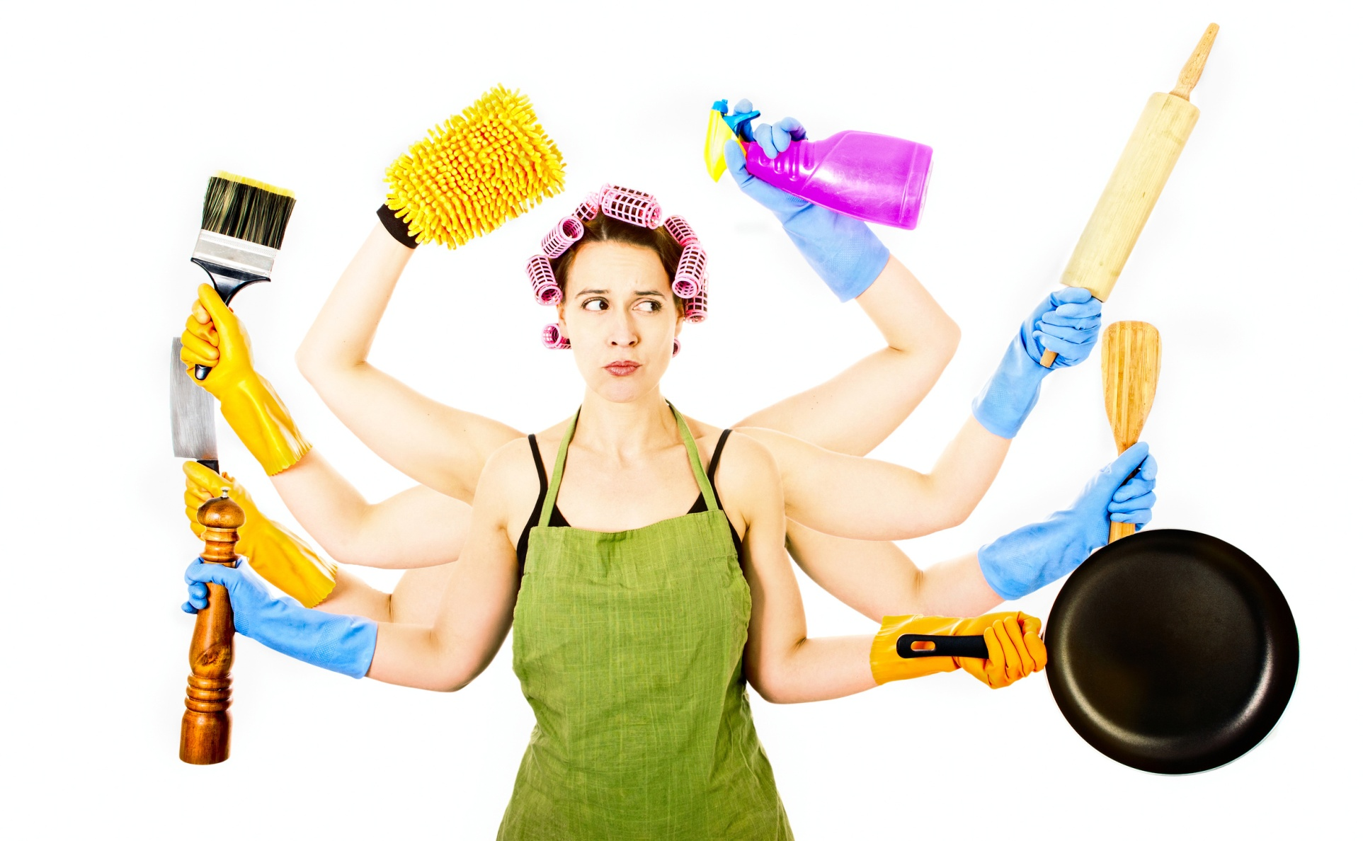
Is it fair for Mother to do all the chores?

Slide 45
Chores | Mother | Father | Sons
washed the dishes
made the beds
vacuumed the carpets
washed the clothes
ironed the clothes
cooked the meals
✔
After
✔
✔
✔
✔
✔
✔
✔
✔
✔
✔
✔

Slide 46
Post-reading lessons

Slide 47
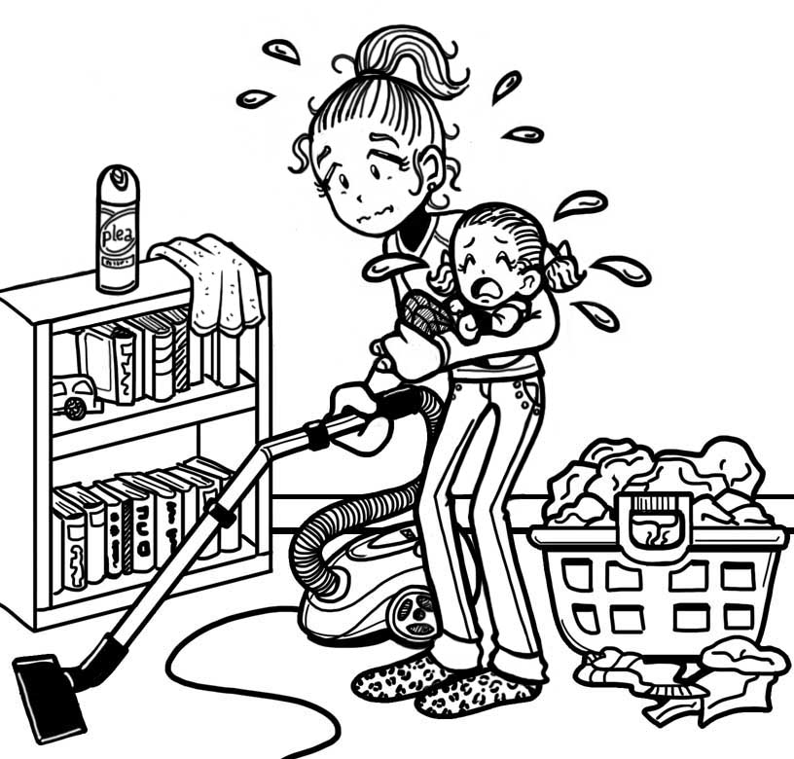
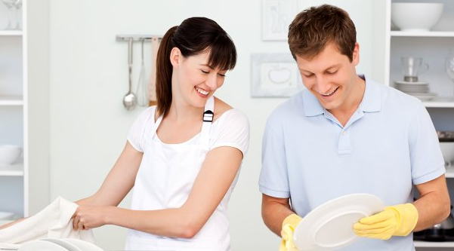
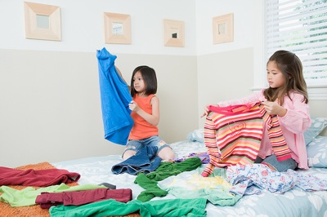
Which part of the story sounds like your family?

Slide 48
What should we do to make doing chores fair for everyone? (ability, skill, will….) (Critical thinking; Gender equality)

Slide 49
Check how you share your chores NOW:
Chores | Mother | Father | Children
1. Do the cooking
2. Wash the dishes
3. Wash the clothes
4. Clean the floor
5. Tidy up
6. Make the beds
7. Take the trash out

Slide 50
Check how you could share your chores fairly:
Chores | Mother | Father | Children
1. Do the cooking
2. Wash the dishes
3. Wash the clothes
4. Clean the floor
5. Tidy up
6. Make the beds
7. Take the trash out

Slide 51
Sharing time!

Slide 52
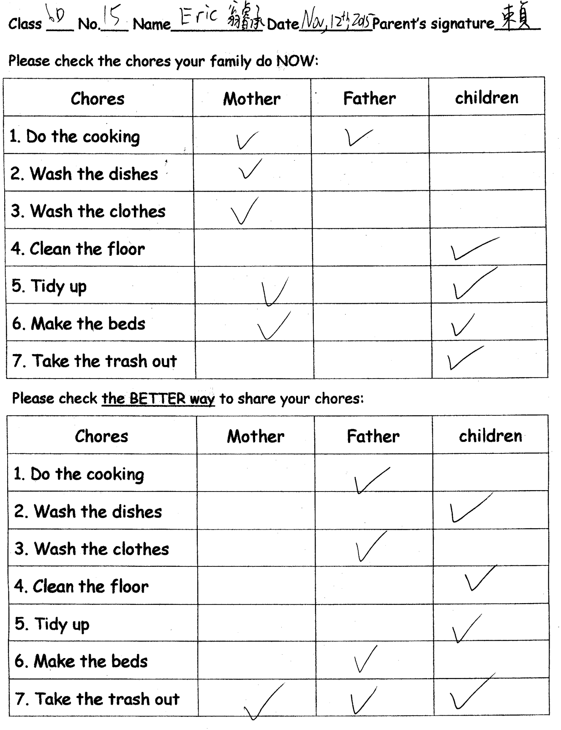

Slide 53
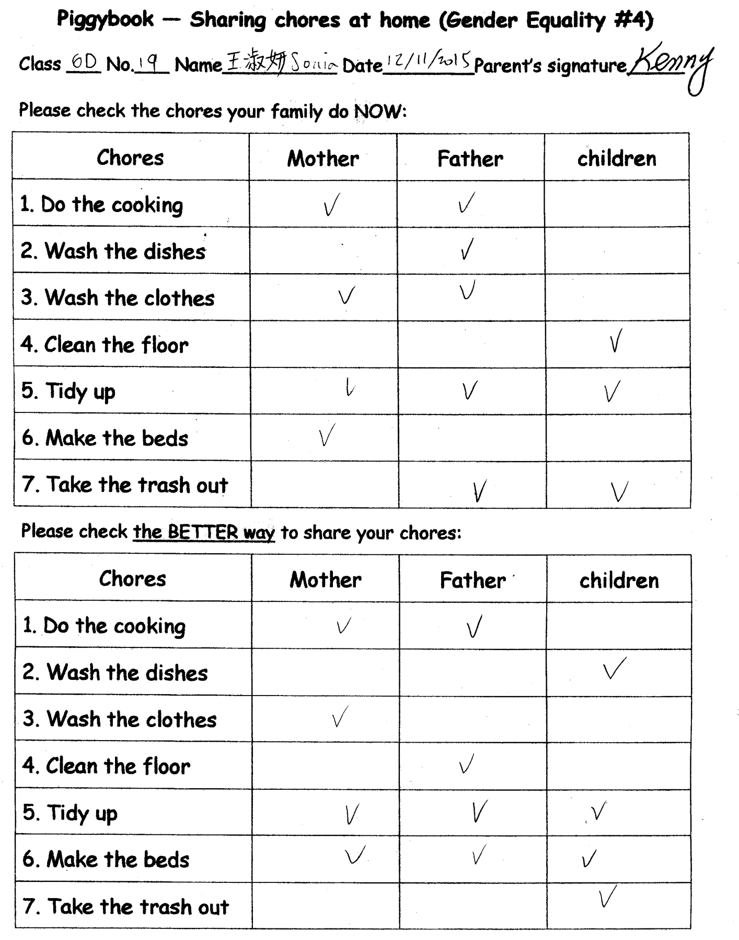

Slide 54
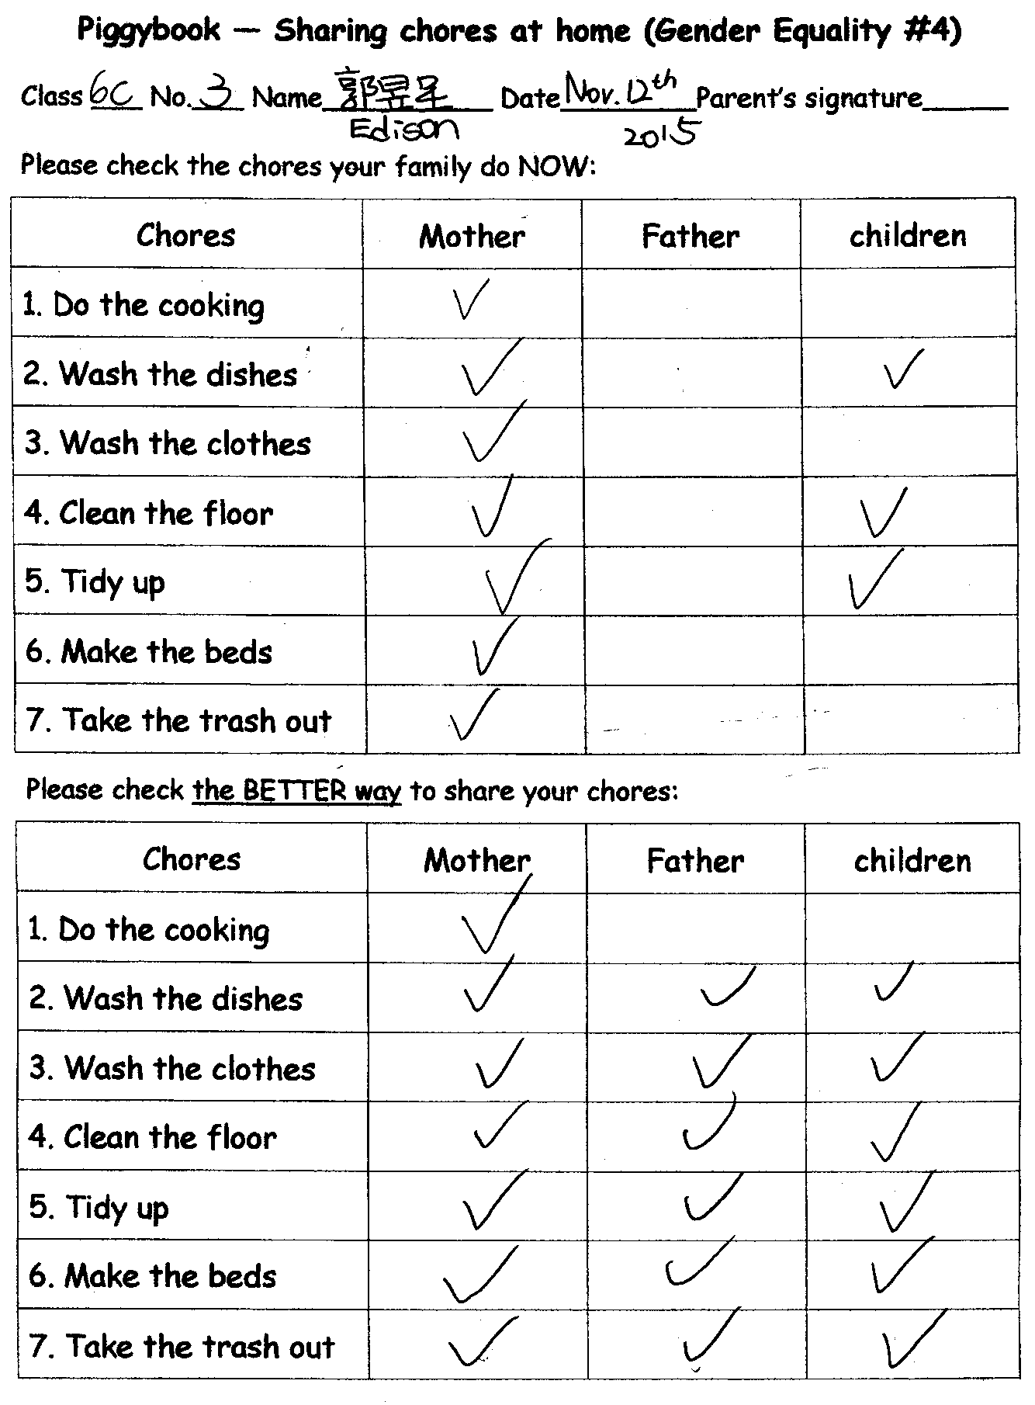

Slide 55
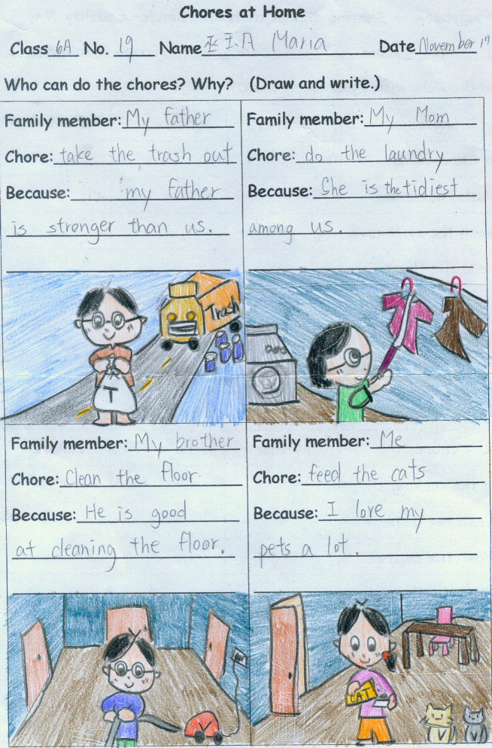

Slide 56
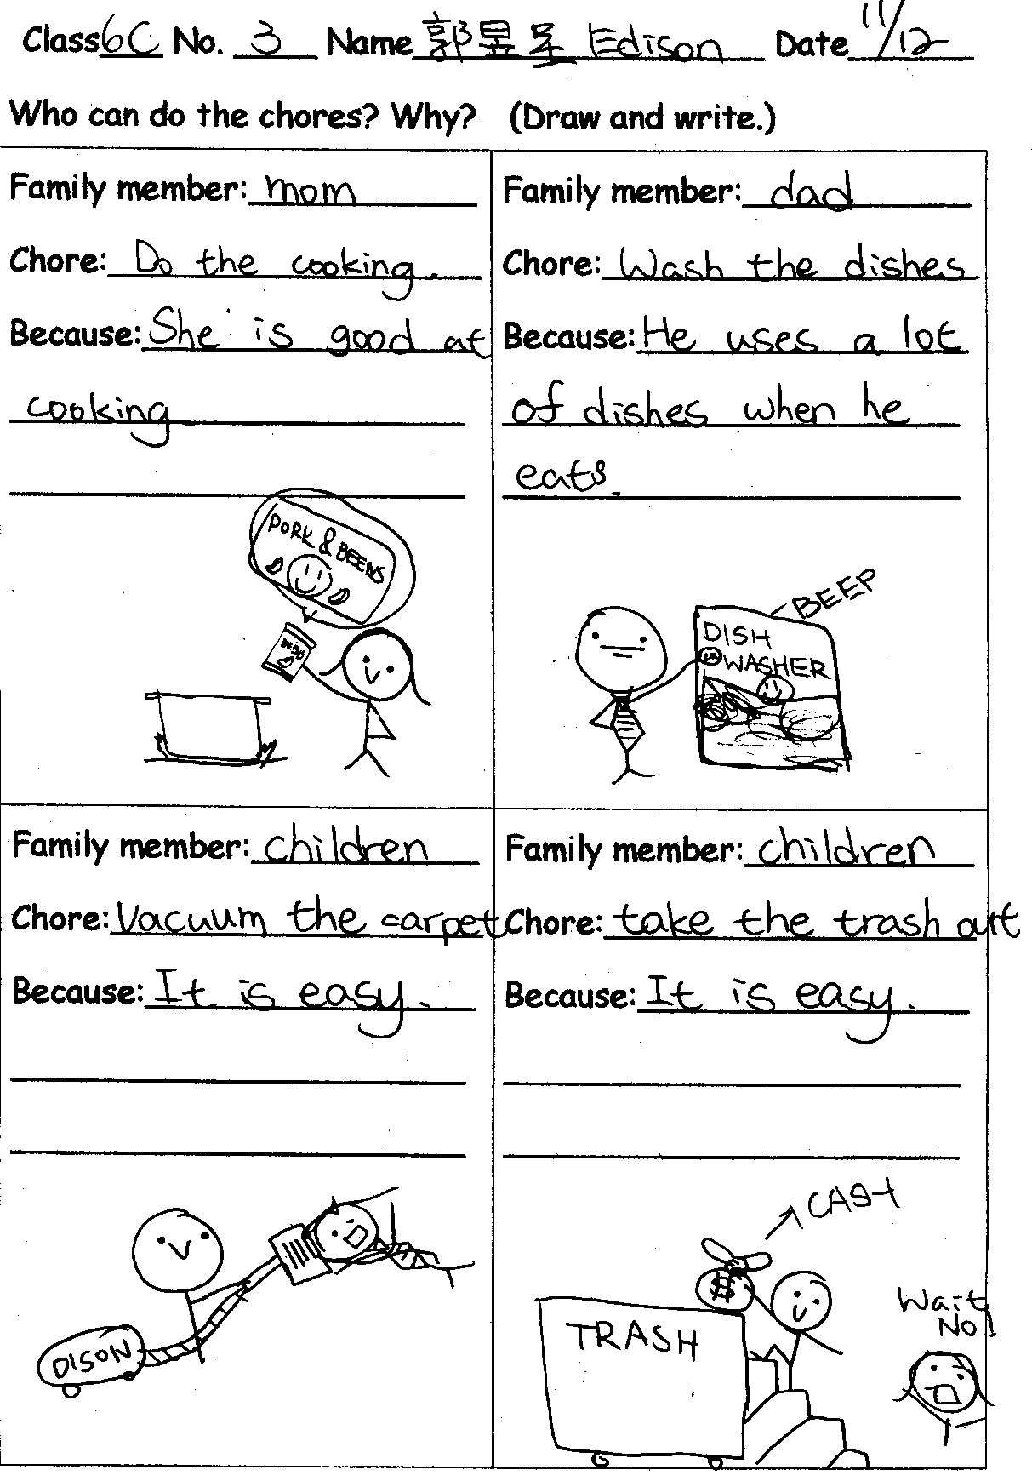

Slide 60
Color
Color is one of the most emotionally evocative of artistic elements.
Red and yellow (warm or hot colors): suggesting excitement, warmth, happiness. However, red can also signify danger or boldness, and yellow cowardice or cheerfulness.
Blue and green (cool or cold colors): suggesting calm or quiet. However, blue can also signify soothing or melancholy, and green envy or illness but also life and renewal.
Colors are used to suggest cultural distinctions (e.g., white is a color of mourning and brides often wear red in Asia).
The use of black and white remains popular. Children seem to enjoy black and white just as much as color.
Dr. Chi-Fen Emily Chen
National Kaohsiung First University of Science & Technology, Taiwan

Slide 61
Dr. Chi-Fen Emily Chen
National Kaohsiung First University of Science & Technology, Taiwan
Color
Value describes the overall intensity or strength of the light.
Darker values are usually associated with gloomier subjects, while lighter ones with happier subjects.

Slide 62
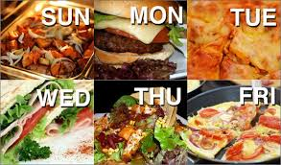
meals

Slide 63
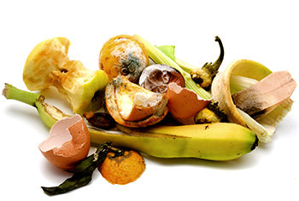
scraps

Slide 64
root around

Slide 65
Irregular past tense verbs
go
leave
come
have/has to
say
take
went
left
came
had to
said
took

Slide 66
Regular past tense verbs
snuffle
snort
squeal
demand
vacuum
mend/fix
snuffled
snorted
squealed
demanded
vacuumed
mended/fixed

Slide 67
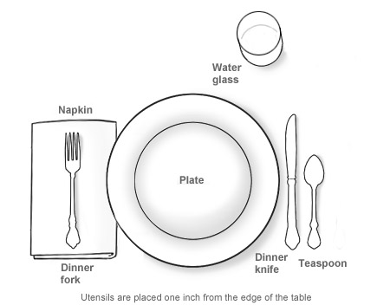
What chores do you have to do at home?

Slide 68
Pre-reading lesson

Slide 69
Irregular past tense verbs
go
leave
come
have/has to
say
take
went
left
came
had to
said
took

Slide 70
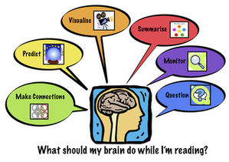
Strategies

Slide 71
Super 6 reading strategies
k

