Slide 1
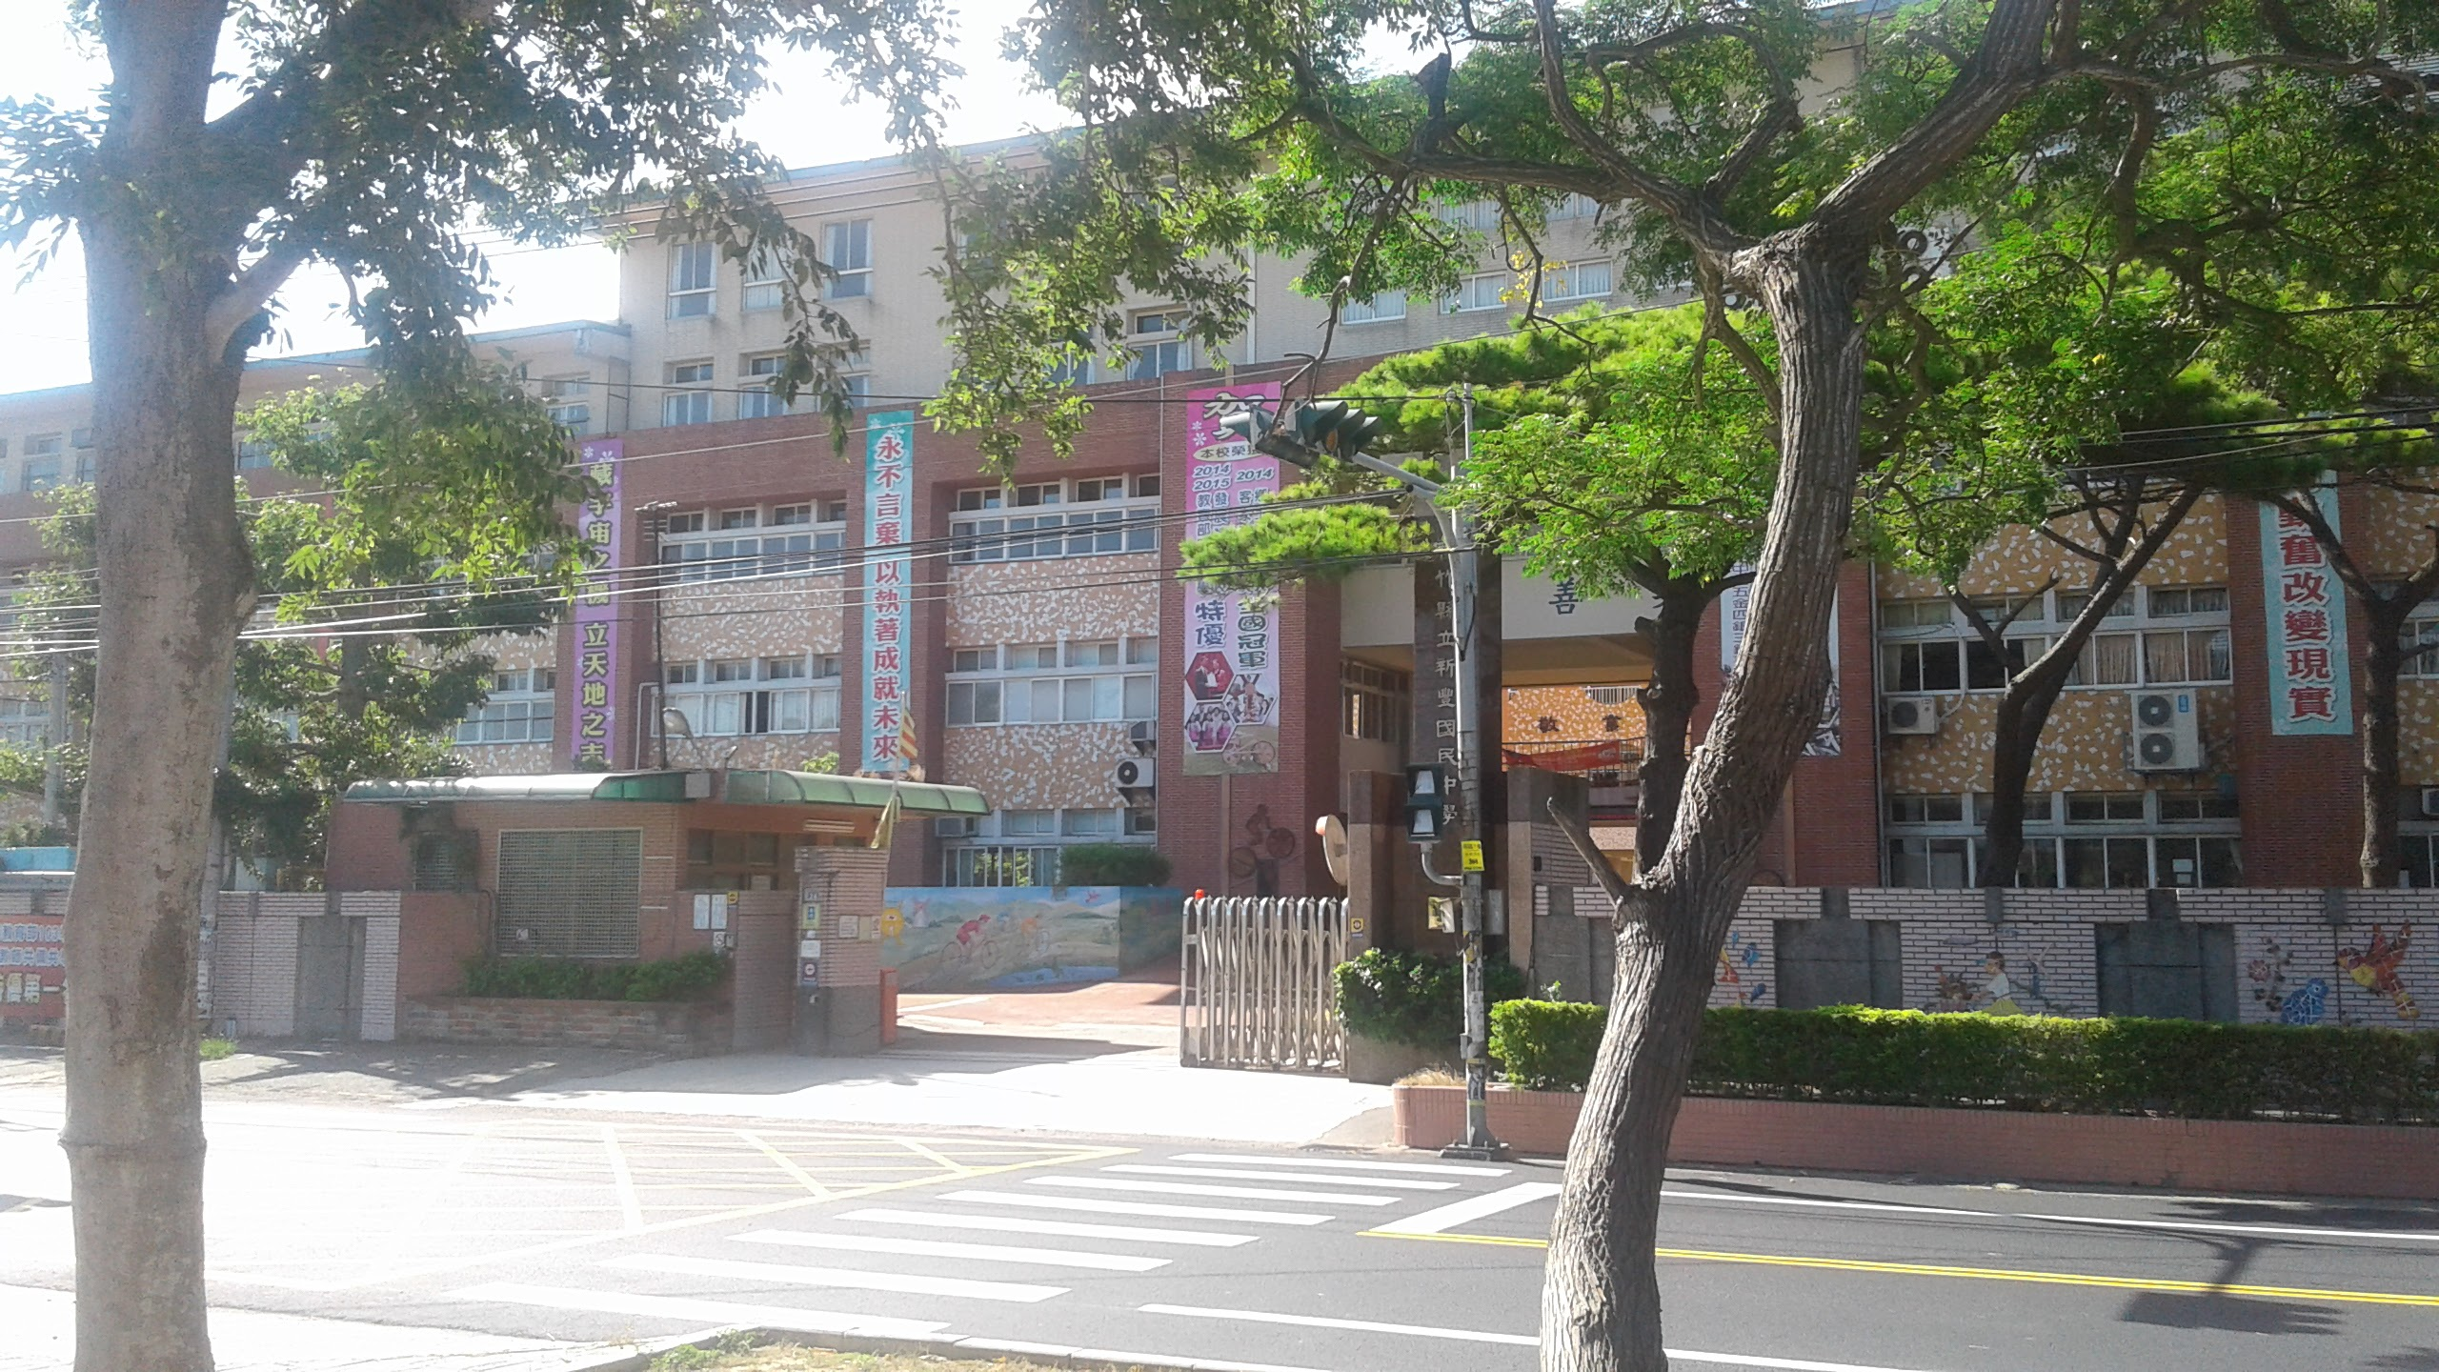
Teaching Strategies
for Whole English Teaching & Learning in the English Classroom
Welcome to an exciting, new teaching experience!
Philip Lewis
Hsinfong Junior-High School
Hsinchu County

Slide 2
Professional background:
Trained as an African languages teacher.
Over 30 years teaching experience.
Taught at all the school levels, universities and teachers’ colleges.
Established my own language consultancy.
Researched extensively on pronunciation T/L and e-Learning.
Written numerous school text books.
I love teaching!

Slide 3
What are your teaching attributes?
Do you have any of these?
Synergy of ideas
Energy
Classroom constantly changes
Versatile
Innovation
Alternative
Teaching out the box
Being original
Student centered

Slide 4
Students’ needs …
Tap into their creativity.
Challenge them to think.
Let them take ownership of …
Recognise different learning styles.
Vary teaching approaches.
Be nurturing and supportive.

Slide 5
What is CLIL?
CLIL stands for “Content and Language Integrated Learning”.

Slide 6
The 4 Language Skills
Listening with understanding (receptive).
Speaking (productive).
Reading with understanding (receptive).
Writing (productive).
In the real world, language skills never occur in isolation
Notes:
45% of the time we are listening when we communicate
50% relates to Ss’ confidence.
In conversations, we listen and we speak.
b) When filling in a form, we read and write.
c) When taking notes, we listen and write.
Consider using an activity such as dictogloss (dictation).
Dictogloss is a classroom dictation activity where learners are required to reconstruct a short text by listening and noting down key words, which are then used as a base for reconstruction.
Example Learners discuss the sea. The teacher then explains the task, and reads a short text on the sea to the class, who just listen. The teacher reads the text again, and the learners take notes. In groups, the learners then reconstruct the text.
In the classroom Dictogloss is often regarded as a multiple skills and systems activity. Learners practise listening, writing and speaking (by working in groups) and use vocabulary, grammar and discourse systems in order to complete the task.
<編號>

Slide 7
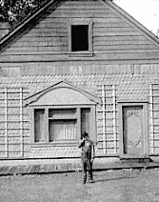
The building blocks for language learning

Slide 8
CLIL: Approaches, activities and ‘s
Teaching vocabulary and sentences
Take Ss from the known to the unknown
Contextualised, comprehensible input
Repetition
Animated gesturing
Notes:
Overview of CLIL:
http://www.fluentu.com/educator/blog/clil-teaching/
Techniques:
http://www.fluentu.com/educator/blog/mfl-activities/
<編號>

Slide 9
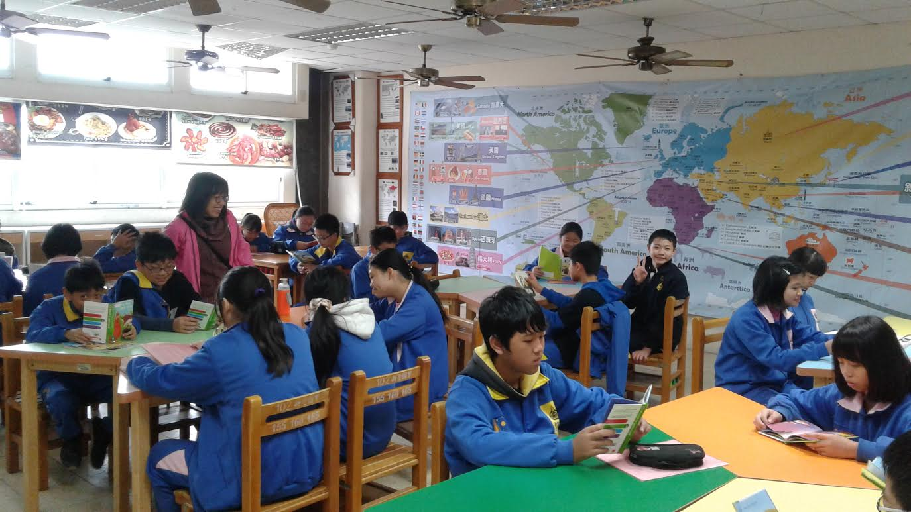
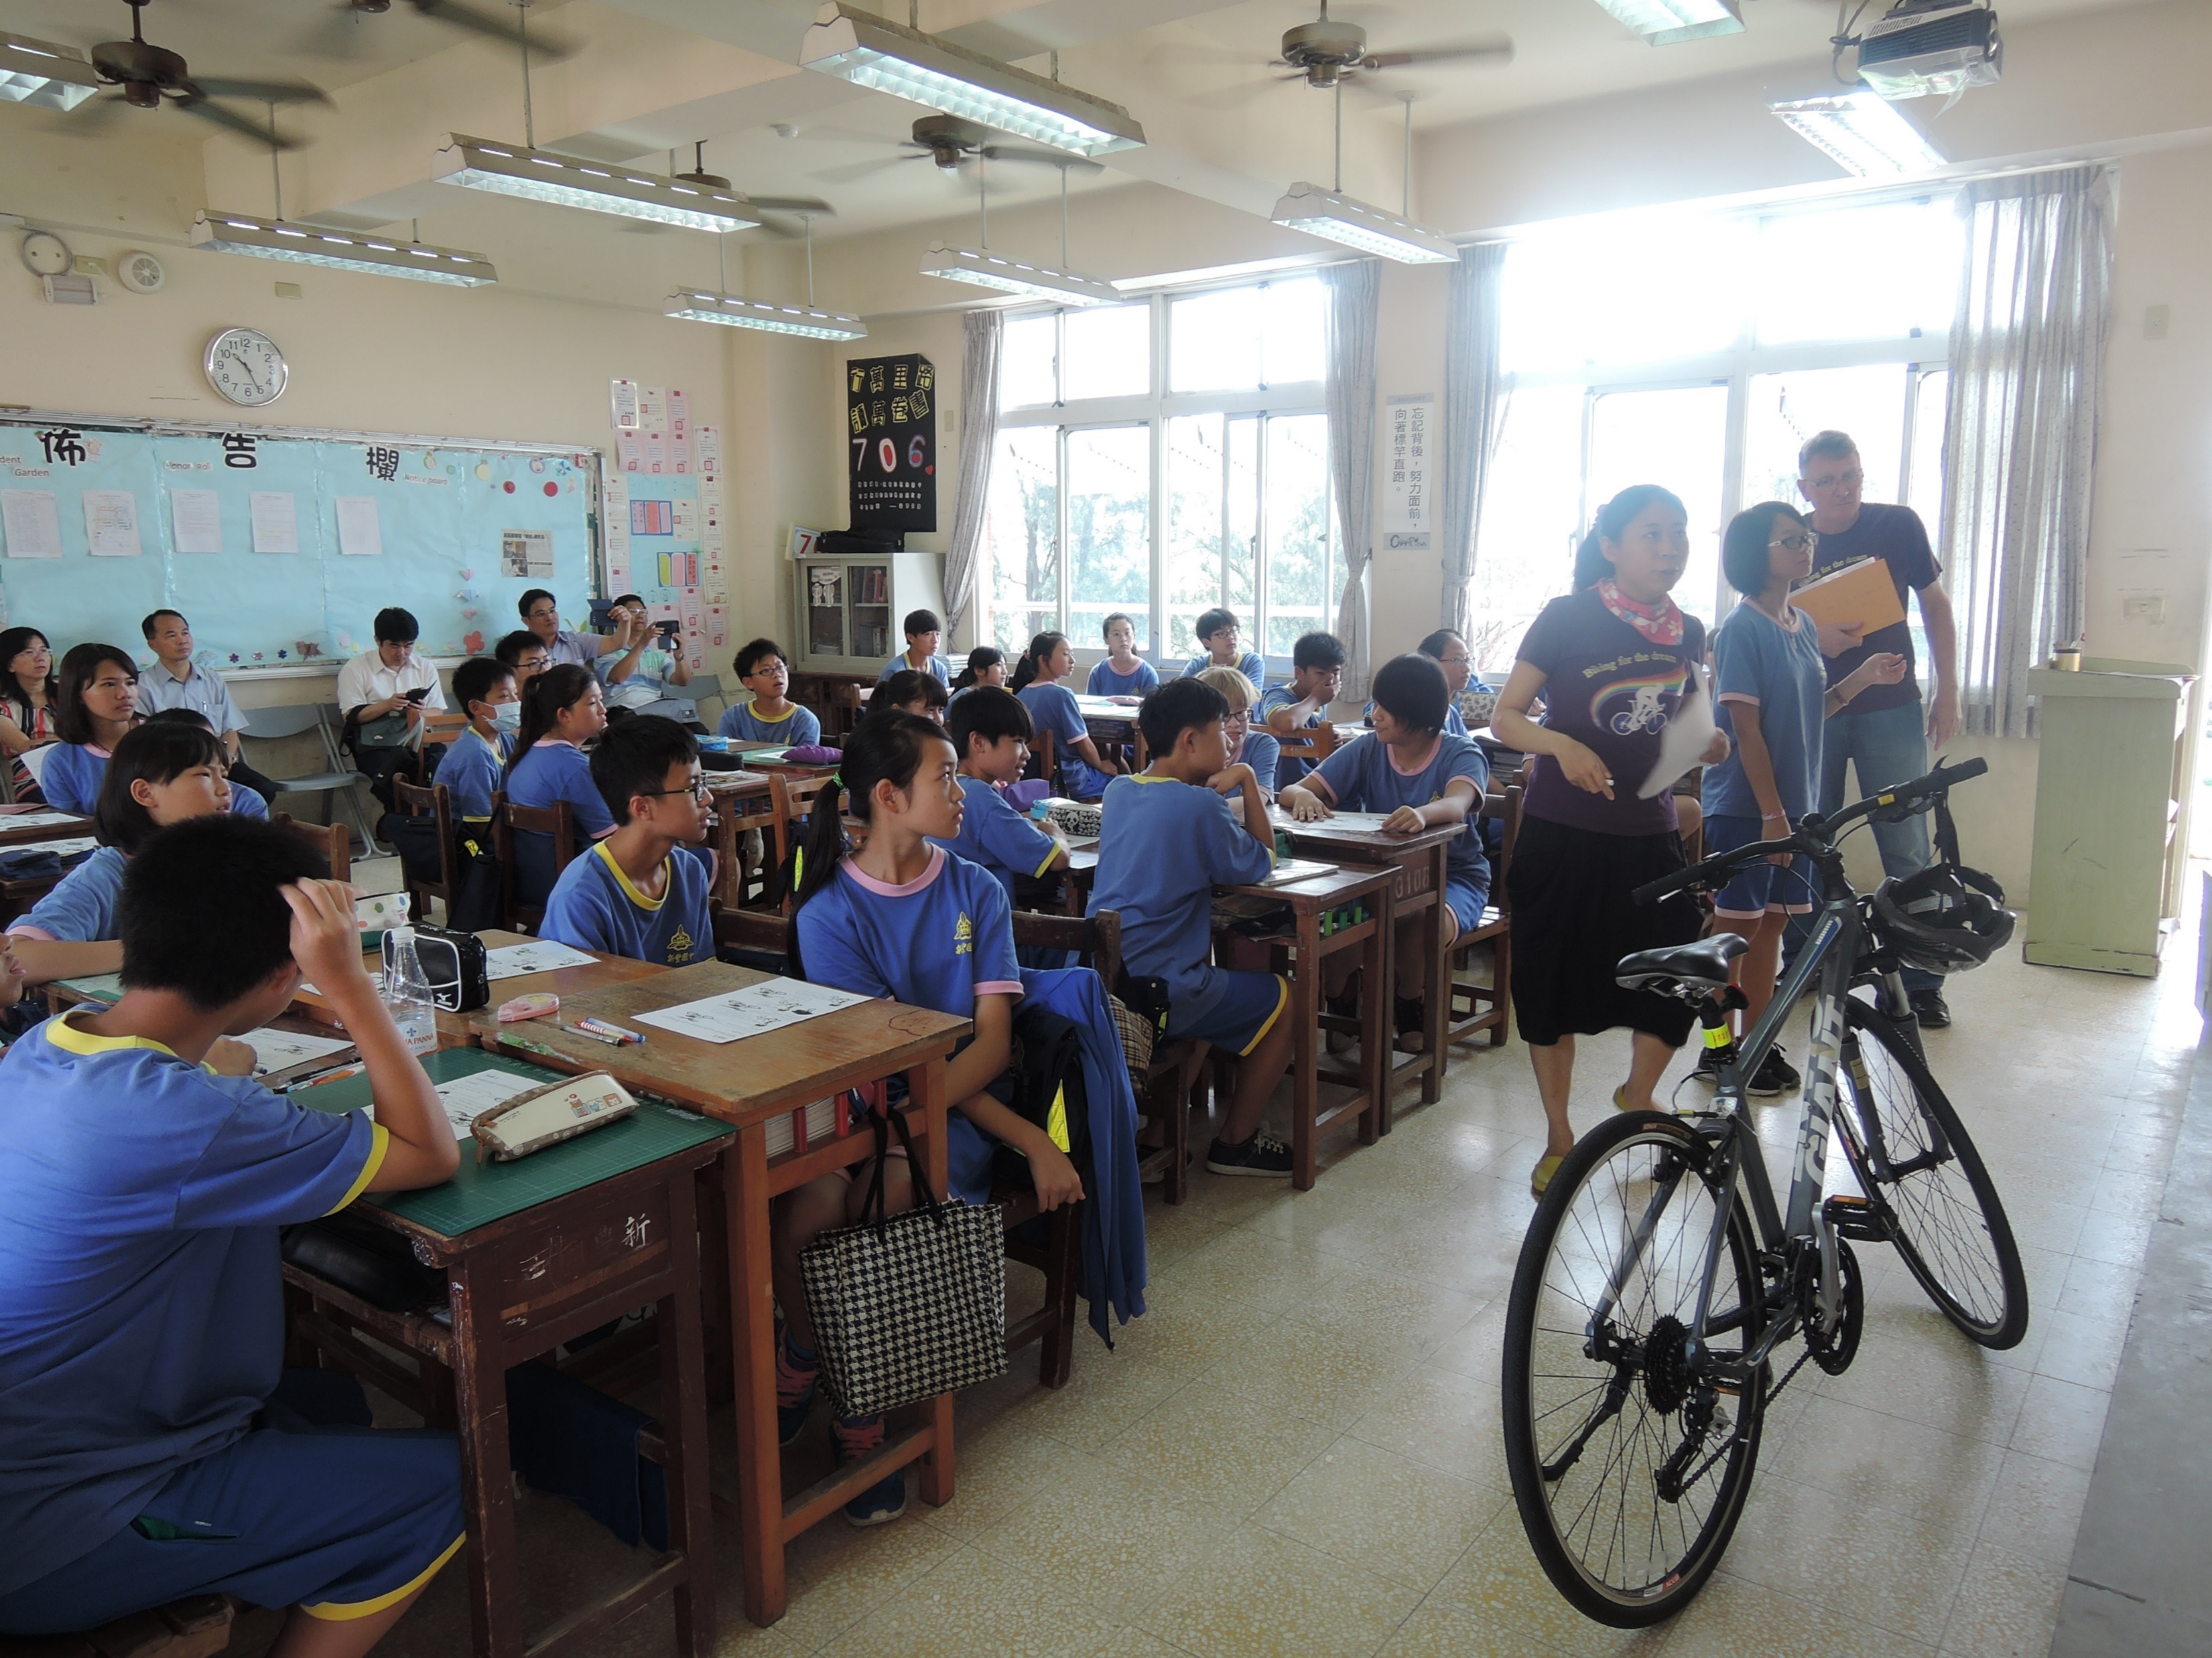
CLIL: Approaches, activities and ‘s
Use of visual aids and props
Realia, maps, PPT*…

Slide 10
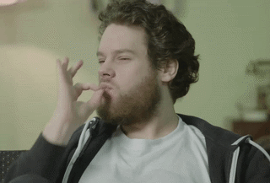
Delicious

Slide 11
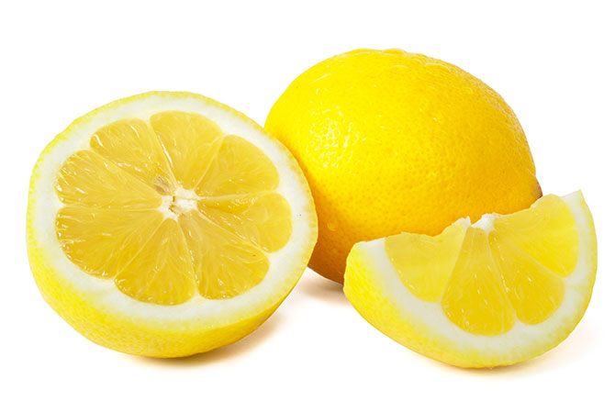
It’s sour

Slide 12
I can do my wkromeho
homework

Slide 13
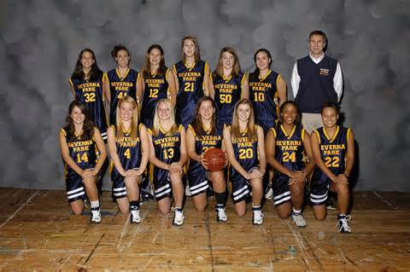
Basketball _____
team

Slide 14
head
arm
eyes
foot

Slide 15
7
2
1
9
7. Close your book
4. Come inside
9. Raise your hand
1. Stand up
6. Knock on the door
2. Pick up your pen
8. Point to the blackboard

Slide 16
food - mouth - don’t - your - in - with - talk
Don’t talk with food in your mouth

Slide 17
In your groups, put these words into the past tense and then make sentences …
Go (5 word sentence)
Cook (6 words)
Wake up (7 words)
Write (8 words)
Drink (9 words)
Watch (10 words)
Sleep (longer than 10 words)

Slide 18
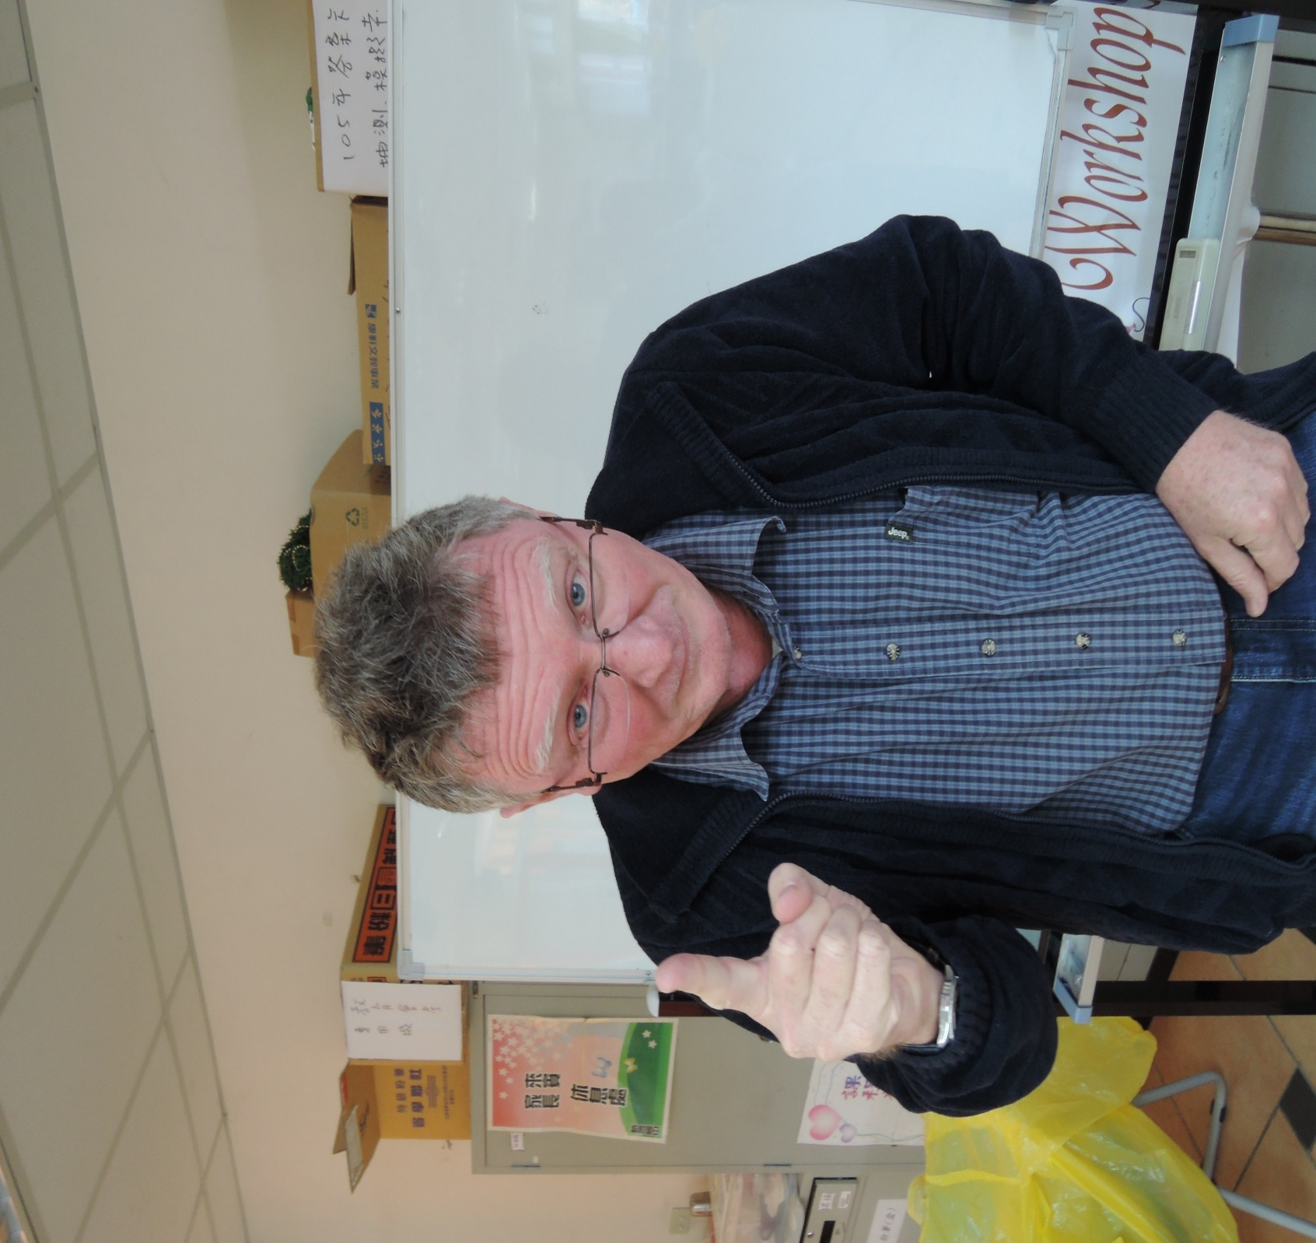
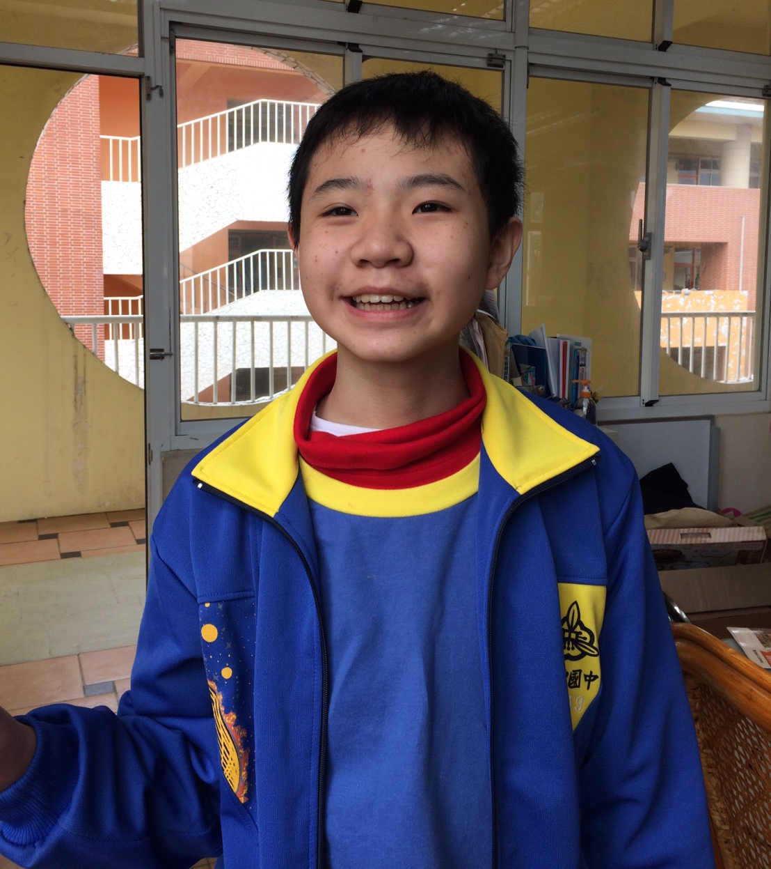
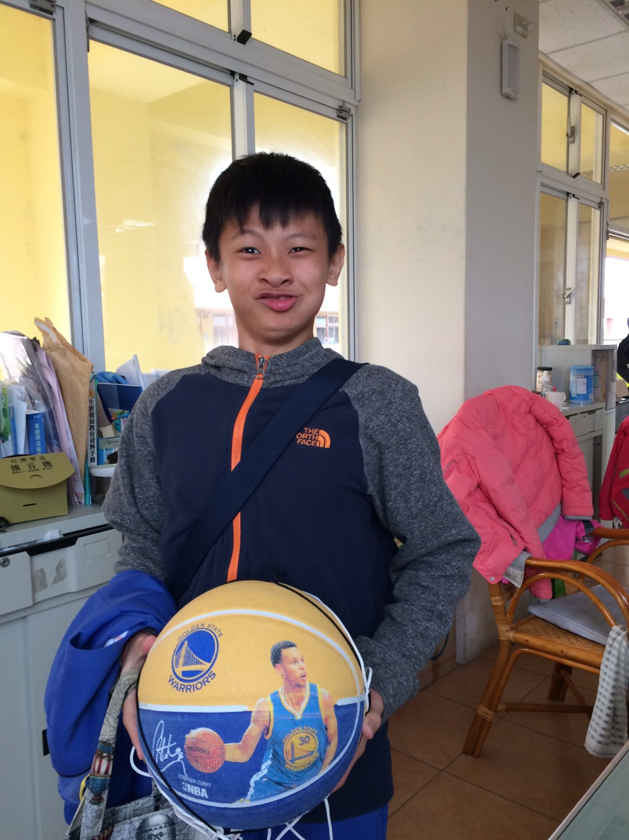
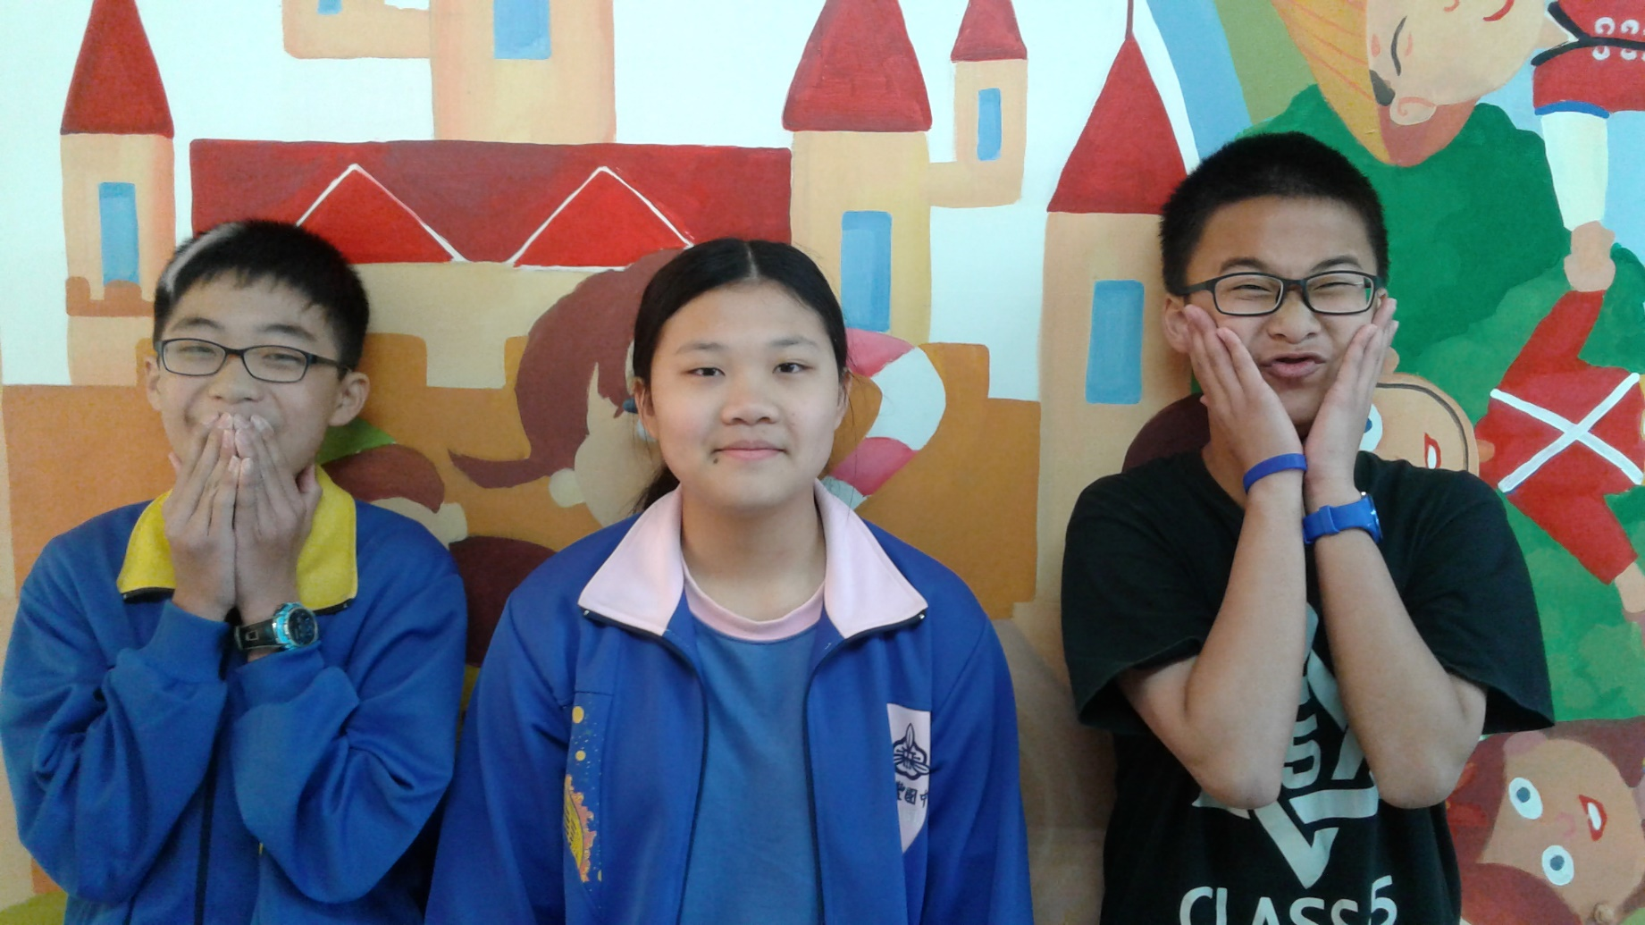
Nick’s busy weekend
Saturday evening
Tests
Saturday morning
Saturday afternoon
Monday - Math
Visit grandma in hospital
Tuesday - English
Birthday party!
Friday - Chinese
Sunday afternoon
Sunday morning
Sunday evening
Go to the movies
Watch NBA basketball on TV
Notes:
Strict father – Nick, remember to do your homework. Nick, you must study hard! Don’t be lazy!
<編號>

Slide 19
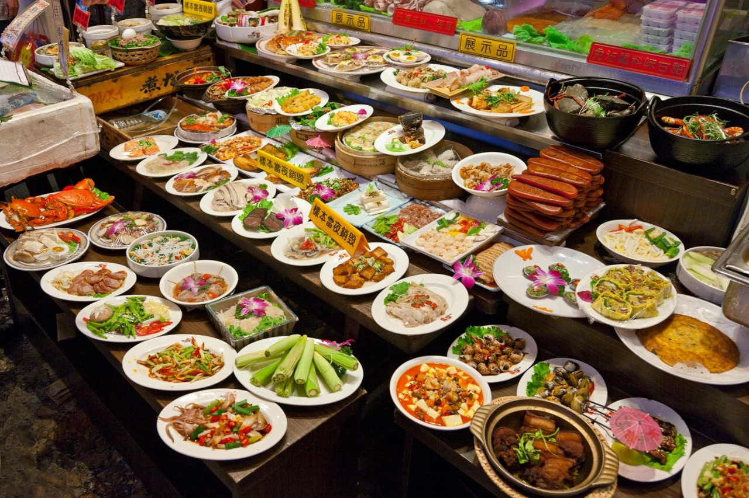
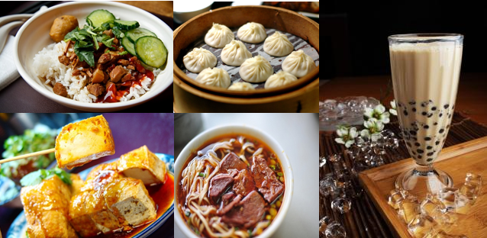
What should Teacher Philip eat and drink?

Slide 20
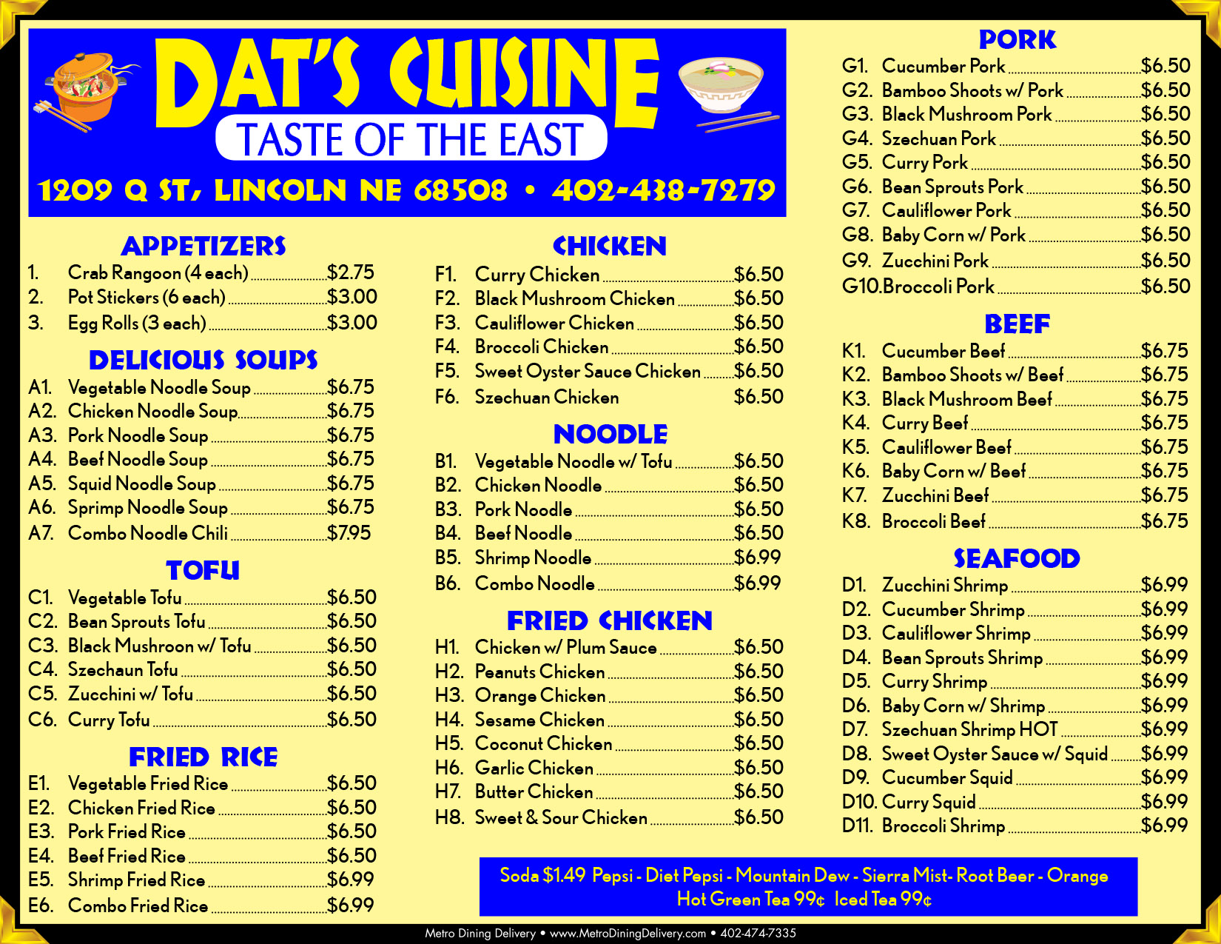
Teacher Philip wants 1 x drink, 1 x soup and a meal with rice, dumplings, seafood and meat.

Slide 21
Answer these questions
What is Taiwan’s most popular food and drink?
What foods and drinks have you chosen?
What do they each taste like?
How much does each ± cost?
What are your 2 favourite foods, why? Also, describe how they taste.
What food don’t you like, why?

Slide 22
CLIL: Approaches, activities and ‘s
Use of task-based activities and worksheets*
Ss can engage individually/ in pairs/ in groups.
Real-life, fun, meaningful and interactive activities/ games …

Slide 23
CLIL: Approaches, activities and ‘s
Chinese vs English during your lesson?
Get cultural
Ss’ outcomes
Be judicious – only when necessary.
Communication gap.
Misunderstanding.
It can be helpful when comparing languages, learning new vocabulary or complex grammar rules.
Can be used more frequently with beginners.
Broaden Ss’ horizons
At all times, be culturally sensitive and respectful
Role play, PPT/ posters, problem solving, research/ surveys, create own songs. Combination of any of the above, Let Ss decide…

Slide 24
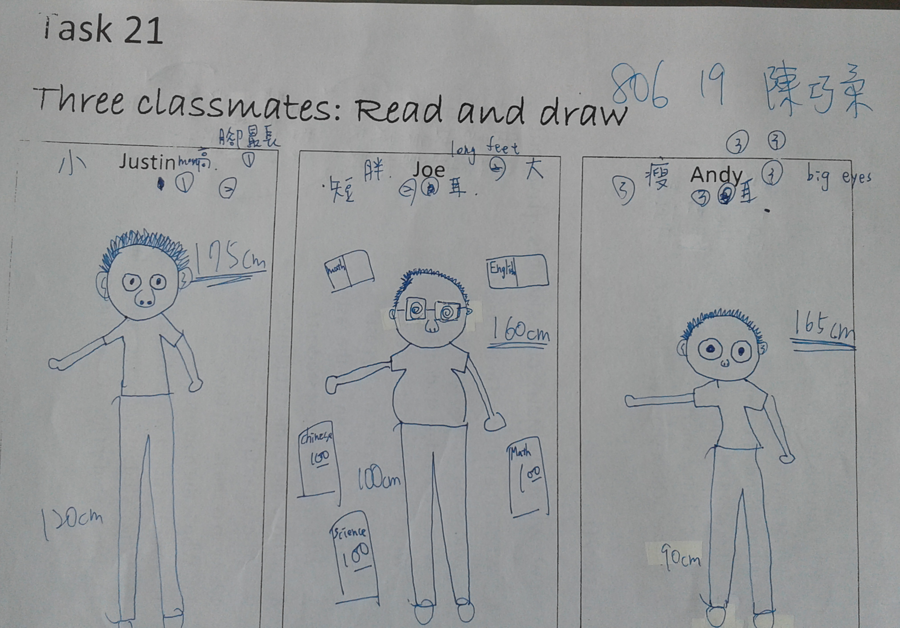
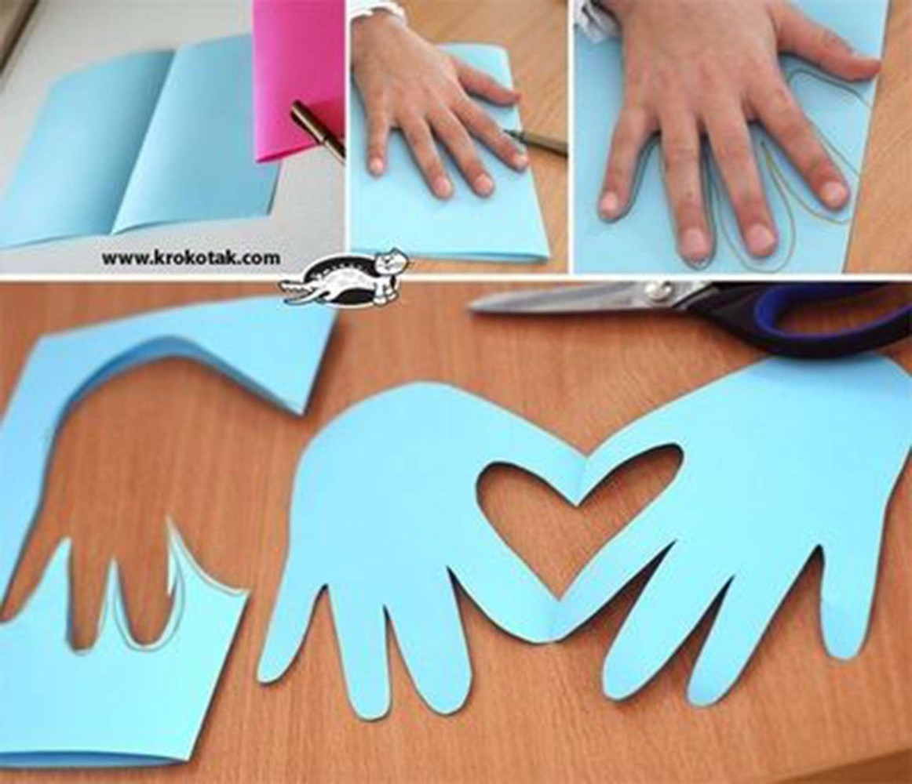
CLIL: Art activities
Allows for rich vocabulary input and output.
Allows Ss to leave with a tangible product.
Activities?*
Listen/read and draw
Themed collages
Other
Ss present artwork
Notes:
Overview of CLIL Art
http://www.fluentu.com/educator/blog/clil-art/
Content (deliver specific information) – Communication – Cognition - Culture
Activities
http://www.fluentu.com/educator/blog/clil-art/
CCCC’s on “culture”: Display costumes/ cultural similarities/ differences
Other:
Combine 2 x animals (combine 2 x animals (words [elephouse) and draw image, describe)
<編號>

Slide 25
CLIL: YouTube
It’s as close as you’ll get to the “real thing”.
Often describes more than what words can ever express.
Integrates outside world in the classroom.
Engages Ss.
Stimulates a wealth of activities.
Notes:
Examples of Youtube lessons
Festivals
Table etiquette (USA family)
Cultural difference (Tom S)
<編號>

Slide 26
CLIL: YouTube examples*
Cultural differences - Foreigner in Japanese home
https://www.youtube.com/watch?v=029kdjdasyM
Table manners
https://www.youtube.com/watch?v=unXKYK0uRJ8
Notes:
Examples of Youtube lessons
Festivals
Table etiquette (USA family)
Cultural difference (Tom S)
<編號>

Slide 27
CLIL: Problem Solving
Why …?
What do you think …?
Positive - Negative - Interesting.
Prove it …!
De Bono’s 6 Thinking Hats.
Notes:
Examples of Youtube lessons
Festivals
Table etiquette (USA family)
Cultural difference (Tom S)
<編號>

Slide 28
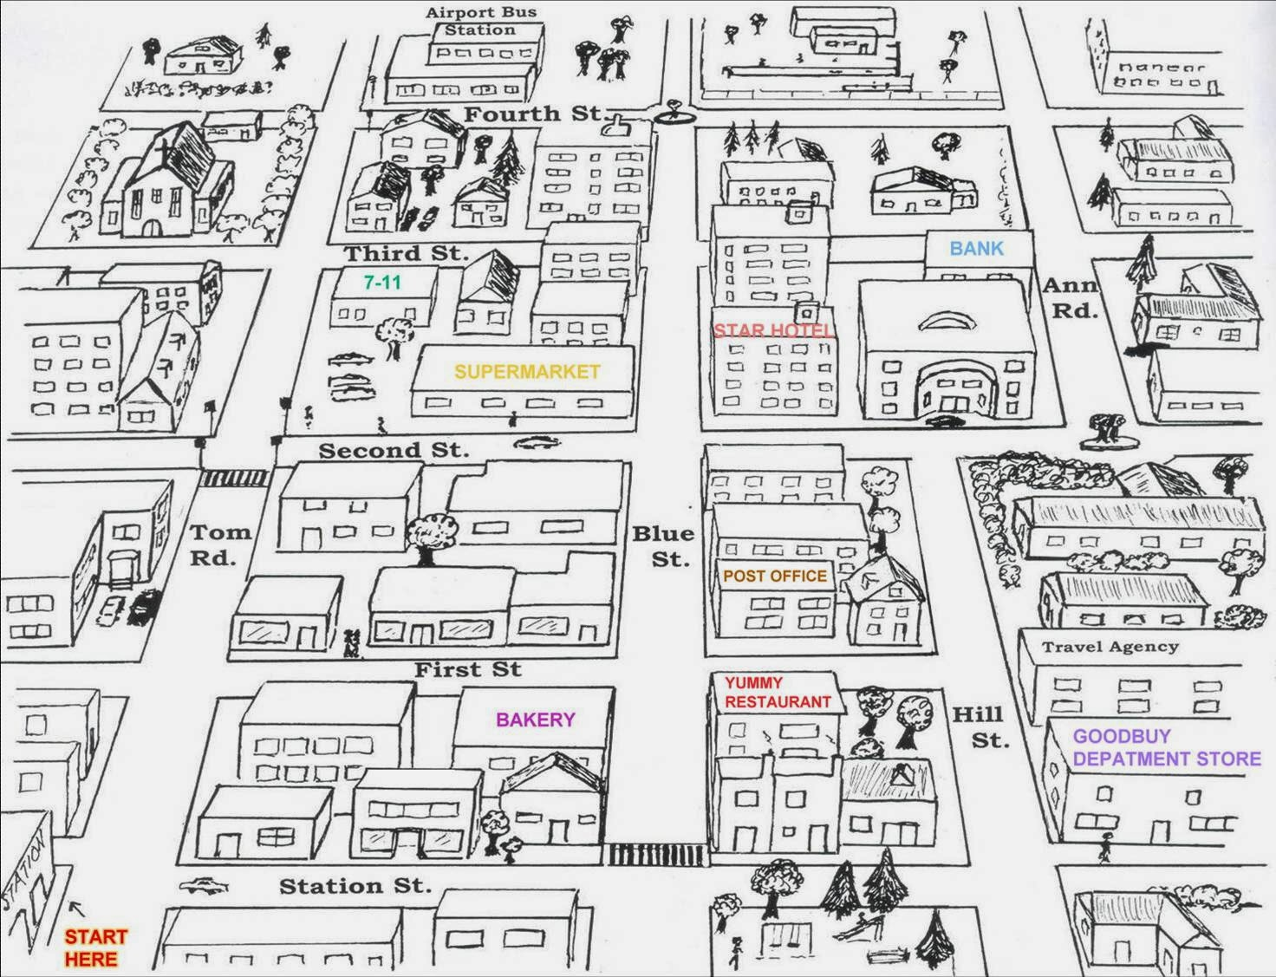
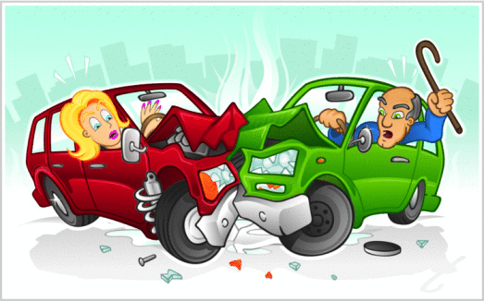
School
Sam’s home
7/ 11 Shop
Hospital
Boutique
Book Store
Big City
Park

Slide 29
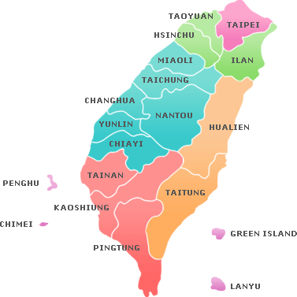
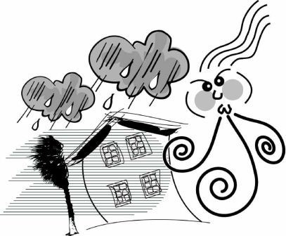
30-32ºC
10 km
80%
25-30ºC
35 km
70%
35 km
25-30ºC
70%

Slide 30
Punctuation
“Lets eat grandpa.”
“Lets eat, grandpa.”
“Jane finds inspiration in cooking her family and her dog.”
“Jane finds inspiration in cooking, her family, and her dog.”

Slide 31
“A woman without her man is nothing.”
"A woman, without her man, is nothing.”
"A woman: without her, man is nothing."

Slide 32
Edward de Bono’s 6 Thinking Hats
"Okay everyone, I want you to put on your thinking caps and try to come up with ways to solve this problem!“.
Notes:
<編號>

Slide 34
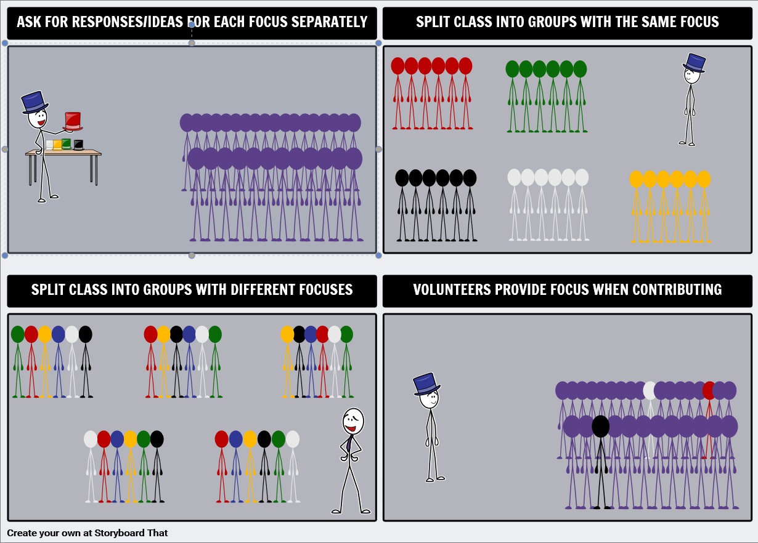
The hats are thinking styles and do not represent a person.
No thinking style (or hat) is better than another.
Wearing another hat allows the people to think differently in contrast to how they often think.

Slide 35
Thinking Hats Topics
Your family is going on holiday. Discuss the best place. The Green Hat begins discussion.
You are a group of teachers. One of your students was caught using dangerous drugs. Should the student be expelled? The Black Hat begins.
Cell phones are going to be banned in your school. The White Hat begins.
Notes:
White hat: factual, describes what is there.
Red hat: intuitive, expresses how one feels (+/-) when one sees the object, gut feeling.
Green hat: creative, comes up with ideas, solutions.
Black hat: negative, sees what is wrong with everything, pick out the faults.
Yellow hat: positive, sees what is good in everything, looks for the benefits.
Blue hat: controls the process, decides which hat to put on when, and concludes.
Order of brainstorming:
White/Red, Yellow/Black, Green/Blue
or
Blue – White – Red – Green – Black – Yellow – Blue
<編號>

Slide 36
Lesson Planning and Design
Students can’t be assessed on content which is unfamiliar
Try to make assessment a fun and learnable experience
Language skills (4+1)
Activities should …
Be fun
Be differentiated
Focus on all the language skills
Bring content back to the personal lives/ experiences of student(s).
Duration
To develop Ss’ Communication Skills
To develop Ss’ Communication Skills
To explore the World!
Icebreaker/ Introduction
Content and Objectives
Process
Variety of interactive activities
Theme
Worksheets
Reflection
Assessment
Notes:
Language skills, focus more on listening and speaking, Type of activities - Knock out activity, Youtubes, Assessment – role play, end of semester big test, online and presentations., use robot and festivals lesson plans as examples
DIFFERENTIATE Tasks!!!!!!!
Fun and interactive – knockout activity!!!!
Youtubes – the flavour of the month, Differentiating tasks, Outcome: oral fluency and assessment
<編號>

Slide 37
Classroom challenges
Ss’ L1 transfer → Interlanguage?
Ss’ confidence?
Ss’ motivation?
Ss’ output vs Google Translate?
T’s attitude towards preparation, presentation → role model?

Slide 38
Application and Presentation
Groups are to:
Design and develop theme-related vocabulary and sentence construction activities to cover 2 x lessons (total preparation time: ±30-40 minutes).
Present an overview of the lesson plans and activities (5 minutes), (total time: ± 20-30 minutes).
Consider:
Using worksheets/ activities which focus on:
4 + 1 Language skills
YouTube, songs, arts & crafts, …
Problem solving skills
Ss’ Outcomes (think alternative!)

Slide 39
Application and Presentation
Lesson themes (handouts):
Be quiet, please. (Gr.7)
What can robots do? (Gr.7)
How can we get to the Bannan Line? (Gr.8)
Did you know LINE had been invented to help people? (Gr.9)

Slide 40
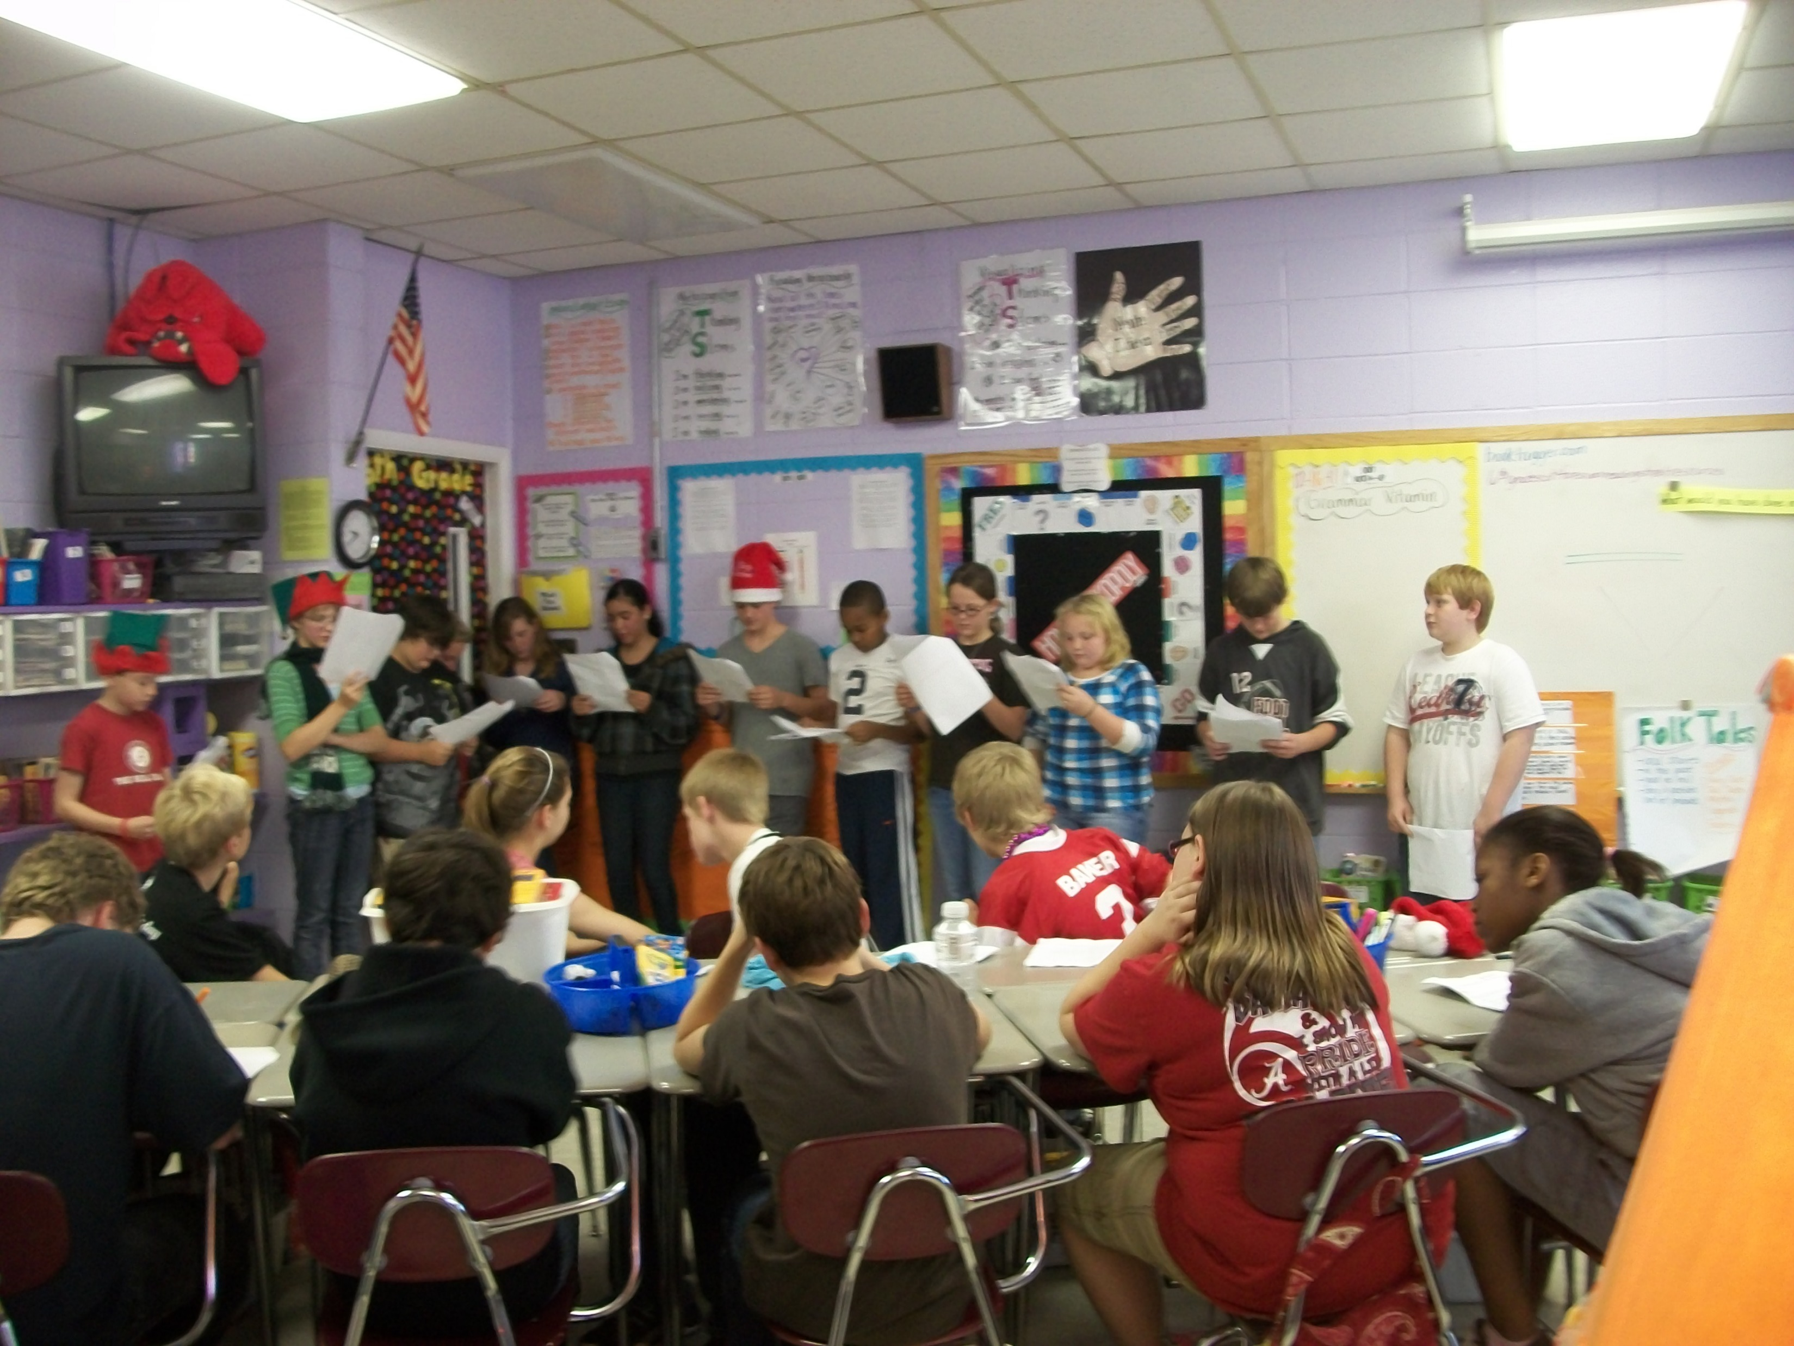
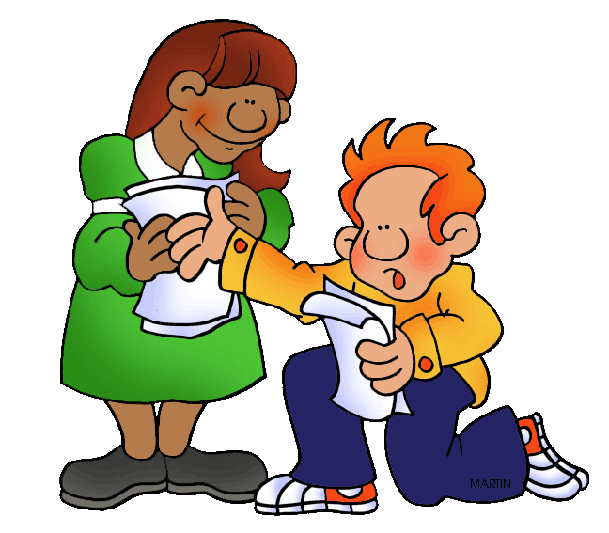
Other ‘s…
Board games.
Readers Theatre.
Dictionaries.
Outdoor activities.
Songs.
Remedial activities.
Notes:
http://www.teachthought.com/pedagogy/101-ways-for-teachers-to-be-more-creative/
Outdoor “classroom”/ activities: Treasure hunt, sport but in English, market day, shopping, just teach outside (a change is as good as a holiday), sport competitions/ superlatives/ degrees of comparison
Remedial: Peer teaching (in pairs/ PPT), self assessment
Reader’s Theatre
http://blog.tesol.org/readers-theater-a-superfood-for-oral-skills/
It requires no sets, costumes, props, or memorized lines. Instead of acting out literature as in a play, the performer’s goal is to read a script aloud effectively, enabling the audience to visualize the action. Performers bring the text alive by using voice, facial expressions, and some gestures
<編號>

Slide 41
Xinfeng Junior-High School English Department Our Strategic Plan
and I got awesome English grades!
I am starting to speak better English to foreigners

Slide 42
Our Vision
We are a forward thinking team committed to our students’ English successes of today and their preparedness for tomorrow.

Slide 43
Our Mission
To be recognised for the development and delivery of innovative English language and communication experiences to:
Promote change
Improve results
Nurture confidence

Slide 44
Interventions to improve English results
… to be realistic and rolled- out!
Less Chinese spoken in the classroom.
Attitude – staff and students.
Grade sub-committees.
Duration of Philip’s communication lessons.
Additional English classes.
Reading intervention.
Online learning.

Slide 45
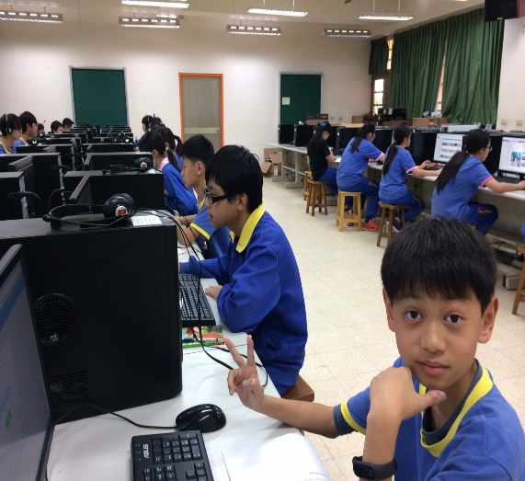
Online learning
An alternative, ‘state of the art’ approach to teaching and learning.
Application: Moodle (LMS) and PoodLL.
Can be adapted for “fit for purpose” needs and requirements.
Feedback readily available.
Remedial work can be conducted thereafter.
Students enjoy it!
Notes:
White hat: factual, describes what is there.
Red hat: intuitive, expresses how one feels (+/-) when one sees the object, gut feeling.
Green hat: creative, comes up with ideas, solutions.
Black hat: negative, sees what is wrong with everything, pick out the faults.
Yellow hat: positive, sees what is good in everything, looks for the benefits.
Blue hat: controls the process, decides which hat to put on when, and concludes.
Order of brainstorming:
White/Red, Yellow/Black, Green/Blue
or
Blue – White – Red – Green – Black – Yellow – Blue
<編號>

Slide 46
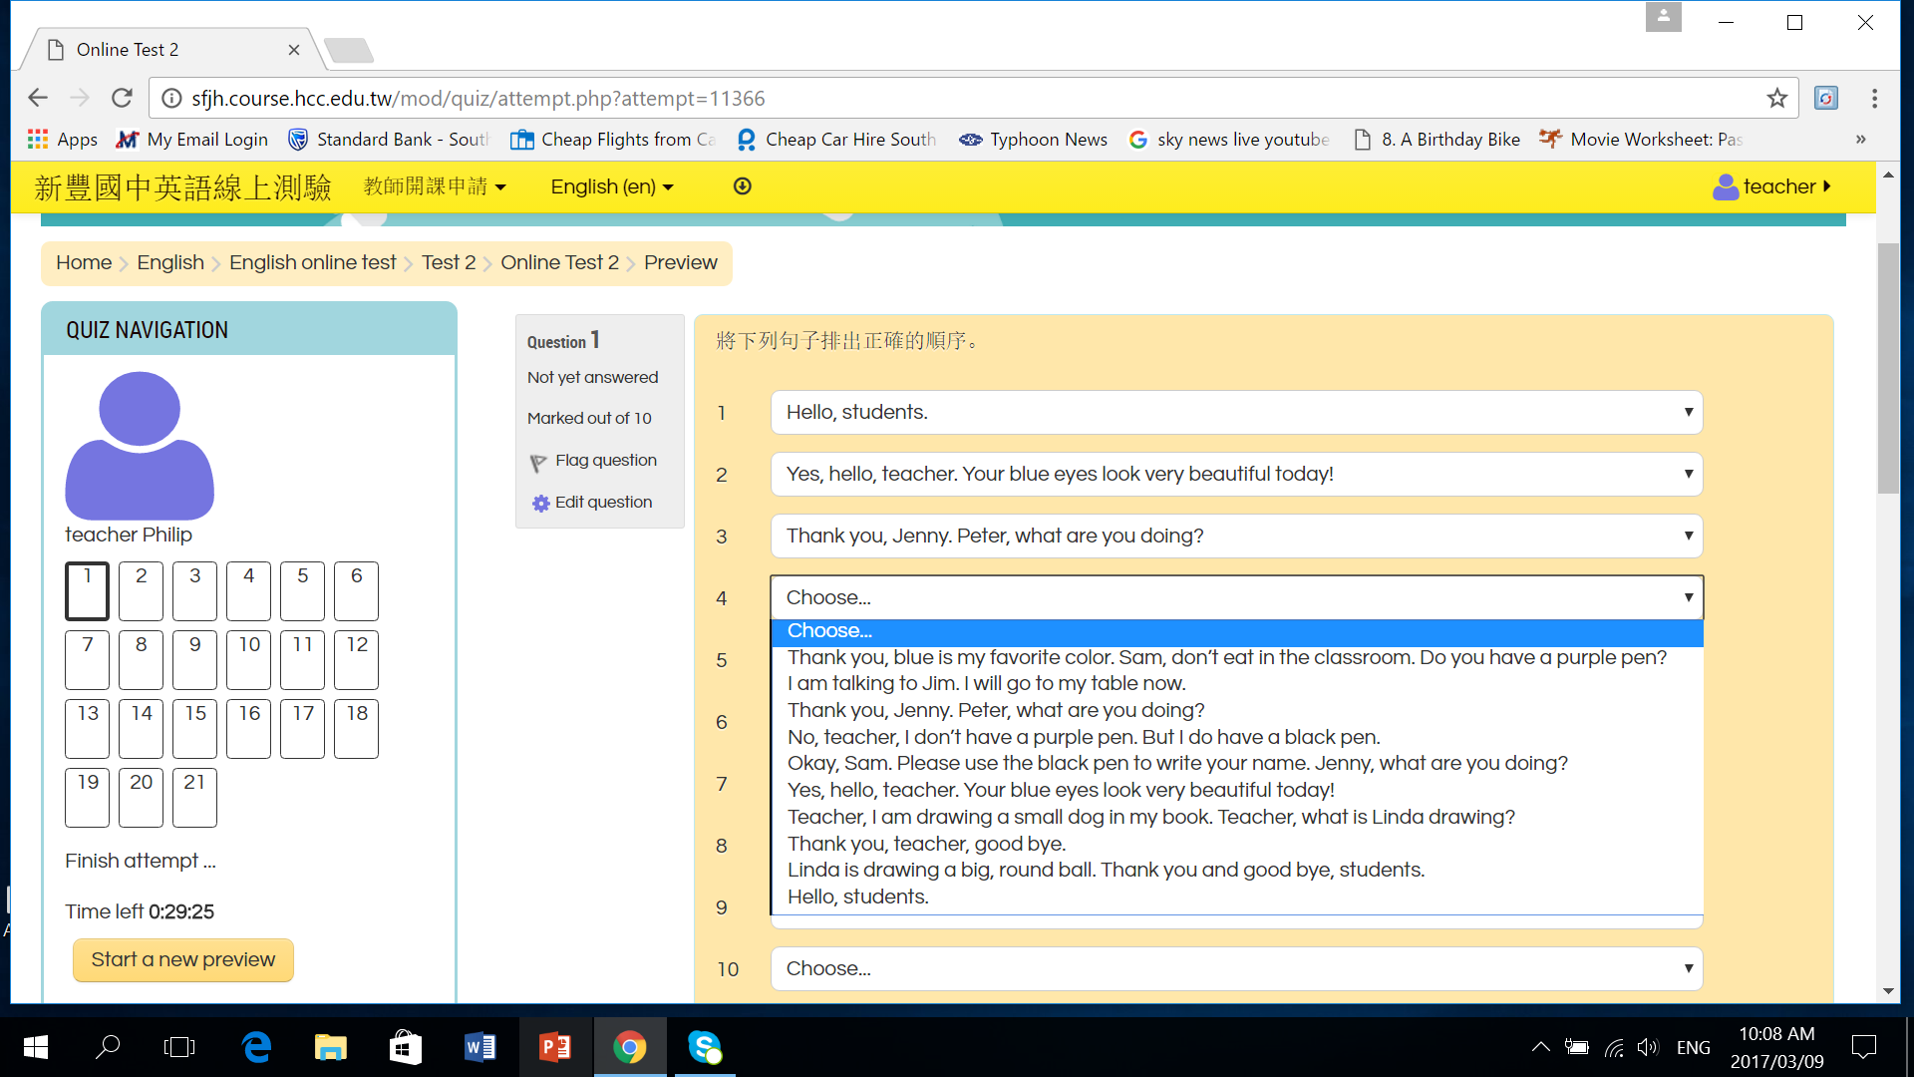

Slide 47
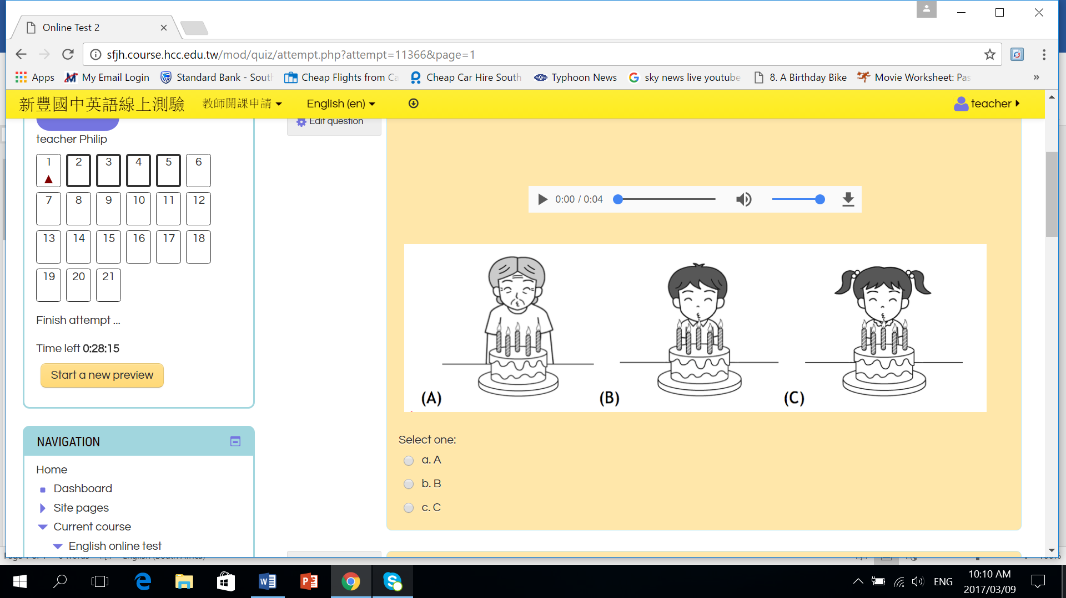

Slide 48
Some ESL websites to consider …
British Council Teaching English
LinguaHouse.com
BusyTeacher
FluentU
Notes:
http://www.teachthought.com/pedagogy/101-ways-for-teachers-to-be-more-creative/
Outdoor “classroom”/ activities: Treasure hunt, sport but in English, market day, shopping, just teach outside (a change is as good as a holiday), sport competitions/ superlatives/ degrees of comparison
Remedial: Peer teaching (in pairs/ PPT), self assessment
Reader’s Theatre
http://blog.tesol.org/readers-theater-a-superfood-for-oral-skills/
It requires no sets, costumes, props, or memorized lines. Instead of acting out literature as in a play, the performer’s goal is to read a script aloud effectively, enabling the audience to visualize the action. Performers bring the text alive by using voice, facial expressions, and some gestures
<編號>

Slide 49
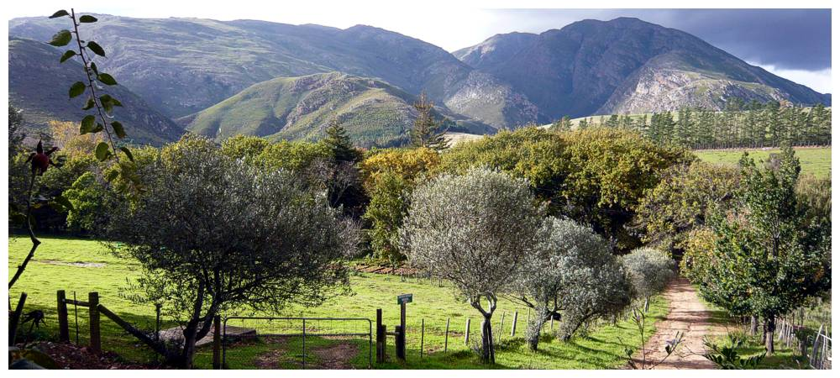
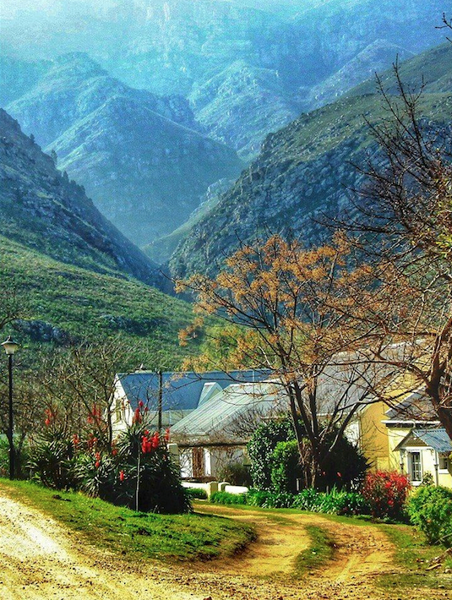
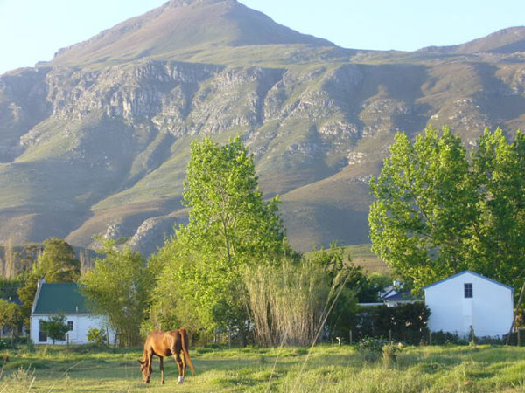
GREYTON

Slide 50
Thank you, and
pwlewis321@gmail.com
Enjoy the Experience!

