Slide 1
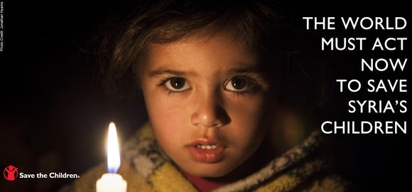
Kids Rights
Jill, Annie, Laura, Kifer

Slide 2
teaching process
Warm up
1. 4 people in group
2. See a clip of the story book the Children We Remember. 3. Ss share their ideas after seeing the clip.
4. T asks the questions about the clip.
What do you see?
What are the things that you can see in the book?
How do you feel?

Slide 4
Where are you from?
Presentation
1. T guides Ss to read the sentence together.
Where are you form? I am from_____.
Taiwan, Japan, France , the USA, Syria
I am from Syria.
2. the news about Syria. https://www.youtube.com/watch?v=b2ZfJhSb-IE
Children’s rights in Syria.
3. T guides Ss to share their ideas about the news.
T: What would you do if it happens to you?
Ss discuss with group members and share their ideas .

Slide 5
Practice
1. Ss write down their ideas on the worksheet.
T gives each groups a piece of white paper.
Ss draw a mind map about the kids rights.
Ss write target sentences on the paper.

Slide 6
Wrap up
homework
Use today’s sentence and words to draw a picture book with your group members.

